Slide 1

Engineering Chemistry(CHY1001)
B.Tech. (Chemistry Cycle)
Module-3
Faculty of Science, Technology and Architecture
School of Physical and Biological Sciences
Department of Chemistry
Manipal University Jaipur

Slide 2

During the process of combustion of a fuel, the atom of carbon, hydrogen etc. combine with oxygen with simultaneous liberation of Heat at rapid rate.
This energy is liberated due to the “rearrangement of valence electrons” in these atoms, resulting in the formation of compounds like CO₂ and H₂O.
Theses compounds have less energy (heat content) as compared to the reactants.
FUEL + O₂
PRODUCTS + HEAT
More heat energy content
Lesser heat energy content
C (s) + O₂(g)
CO₂(g) + Heat
2H₂ (g) + O₂(g)
2H₂O (g) + Heat

Slide 3
Classification of Fuels
These can be classified based on their:
Occurrence (and preparation) and
Physical state
Based on occurrence:
Primary fuel
Secondary fuel
Based on physical state:
Solid fuel
Liquid fuel
Gaseous fuel

Slide 4
Classification of Fuels
These can be classified based on their:
Occurrence (and preparation) and
Physical state
Based on occurrence:
Primary fuel
Secondary fuel
Based on physical state:
Solid fuel → Wood, coal (peat/lignite)
Liquid fuel → Crude oil, tar, diesel, petrol
Gaseous fuel → Natural gas, coal gas

Slide 5
Classification of Fuels
These can be classified based on their:
Occurrence (and preparation) and
Physical state
Primary fuels occur in nature as such.
E.g., wood, peat, coal, petroleum, and natural gas.
Based on occurrence:
Primary fuel
Secondary fuel
Secondary fuels are derived from the primary fuels by further chemical processing.
E.g., coke, charcoal, kerosene, coal gas, producer gas etc.
Based on physical state:
Solid fuel
Liquid fuel
Gaseous fuel

Slide 6
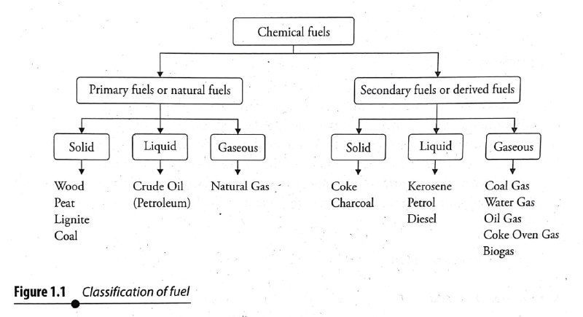
Classification of Fuels

Slide 7
What makes a good fuel?
High calorific value -----------
Ignition temperature ---------
Moisture content --------------
Noncombustible matter -----
Velocity of combustion -------
Combustion products ---------
Cost -------------------------------
Storage and transportation -
Size --------------------------------
Controllability ------------------
Releases large amount of heat
Must be moderate
Lower is better
Lower is better
Must be moderate
Must not be harmful
Must be cheap and plentiful
Must not be hazardous
Solid fuel must be uniform
Must be easy to start/stop

Slide 8
Pros and Cons
Solid fuel:
Advantages
Easy to transport, store
Low production cost
Moderate ignition temperature
Disadvantages
High ash content – low efficiency
Hard to control
High handling cost
Low calorific value
Large excess of air is needed
Internal combustion – not possible

Slide 9
Pros and Cons
Liquid fuel:
Advantages
High calorific value
Less waste, pollution
Easy to control, transport
Can be stored indefinitely
Less furnace space, excess air
Less wear and tear
Can be used as internal combustion fuel
Disadvantages
High cost
Special storage is needed
Greater risk of hazards
Odour
Special instruments are required
Gaseous fuel:
Advantages and Disadvantages
All those from the liquid fuel – in greater extent

Slide 10
Calorific value
Definition:
The heating value (or energy value or calorific value) of a substance, usually a fuel or food, is the amount of heat released during the combustion of a specified amount of it.
The energy value is a characteristic for each substance.
System | Solid/Liquid Fuels | Gaseous Fuels
CGS MKS BTU SI | calories/gm kcal/kg BTU/lb joule/kg | calories/cm³ kcal/m³ BTU/ft³ joule/m³

Slide 11
Calorific value
The quantity of heat can be measured in the following units:
Units |  | Amount of water | By temperature
Calorie (cal) | Amount of heat required to raise the temperature of | 1 gm | 1°C
Kilo calorie (kcal) |  | 1 kg | 1°C
British Thermal Unit (BTU) |  | 1 lb | 1°F
Centigrade Heat Unit (CHU) |  | 1 lb | 1°C
Conversion factors:
1 cal/g = 1 kcal/kg = 1.8 B.T.U./lb
1 kcal/m³ = 0.1077 B.T.U./ft³
1 B.T.U./ft³ = 9.3 kcal/m³
1 calorie = 4.184 joules
1 kcal = 1000 cal = 4184 joules
    1 B.T.U. = 252 cal = 0.252 kcal
        1 kcal = 3.968 B.T.U.= 2.2 C.H.U.

Slide 12
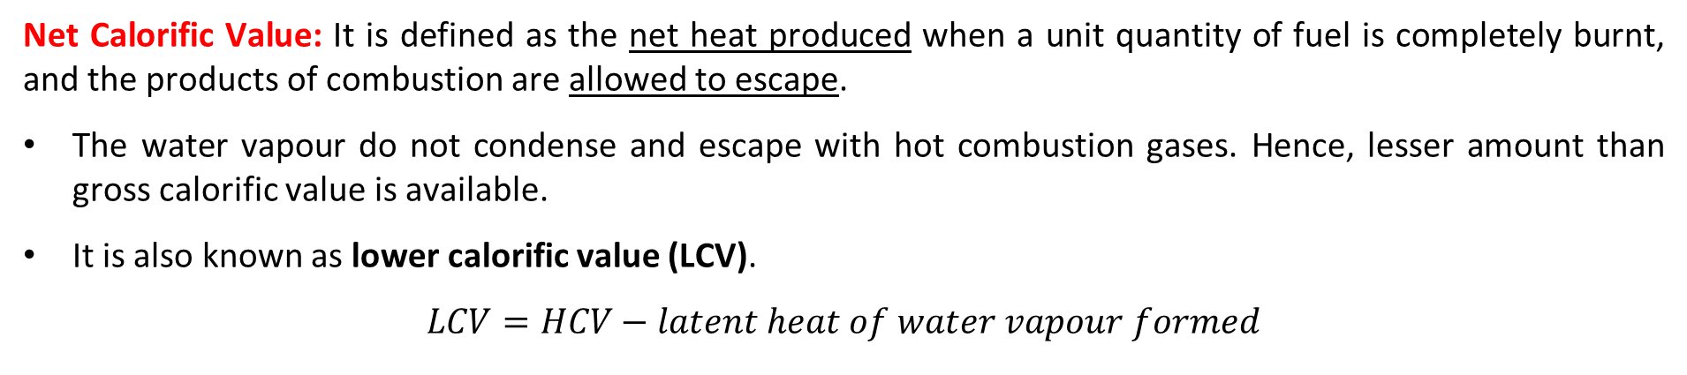
Gross and Net calorific Value
Gross Calorific Value (GCV): It is the total amount of heat generated when a unit quantity of fuel is completely burnt in oxygen and the products of combustion are cooled down to the room temperature.
As the products of combustion are cooled down to room temperature, the steam gets condensed into water and latent heat is evolved. Thus, in the determination of gross calorific value, the latent heat also gets included in the measured heat.
Gross calorific value is also called the higher calorific value (HCV).
The calorific value which is determined by Bomb calorimeter gives the higher calorific value (HCV)
Net Calorific Value: It is defined as the net heat produced when a unit quantity of fuel is completely burnt, and the products of combustion are allowed to escape.
The water vapour do not condense and escape with hot combustion gases. Hence, lesser amount than gross calorific value is available.
It is also known as lower calorific value (LCV).
$$LCV=HCV−latent heat of water vapour formed$$

Slide 13

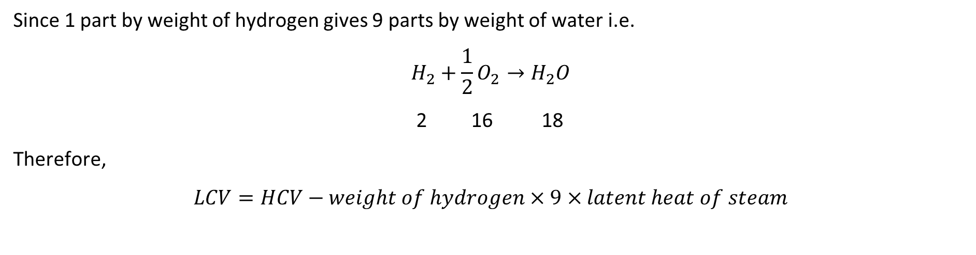
Gross and Net calorific Value
Since 1 part by weight of hydrogen gives 9 parts by weight of water i.e.
$$H_{2}+\frac{1}{2}O_{2}→H_{2}O$$
2 16 18
Therefore,
$$LCV=HCV−weight of hydrogen×9×latent heat of steam$$
$$=HCV−weight of hydrogen×9×587$$
$=HCV−0.09H×587 cal$ (in percentage)

Slide 14
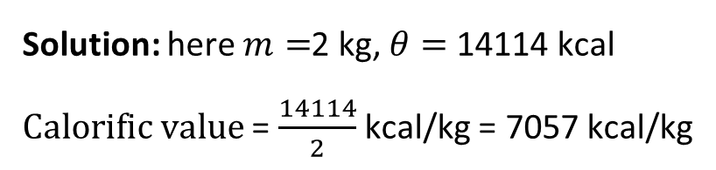
Problem
Q1. 2 kg of a fuel sample upon burning in a calorimeter, liberated 14114 kcal of heat. Calculate the calorific value of the fuel.
Solution: here $m=$2 kg, $θ=$14114 kcal
$Calorific value$ = $\frac{14114}{2}$ kcal/kg = 7057 kcal/kg

Slide 15
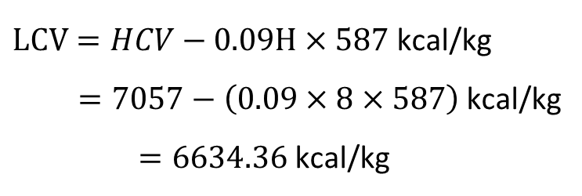
Problem
Q1. 2 kg of a fuel sample upon burning in a calorimeter, liberated 14114 kcal of heat. Calculate the calorific value of the fuel. Please note that the fuel contains 8% of hydrogen.
Solution: here $m=$2 kg, $θ=$14114 kcal
$Calorific value$ = $\frac{14114}{2}$ kcal/kg = 7057 kcal/kg
$LCV=HCV−0.09H×587$kcal/kg
$=7057−\left(0.09×8×587\right)$ kcal/kg
$=6634.36$ kcal/kg

Slide 16
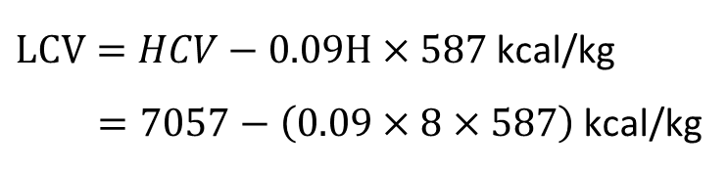
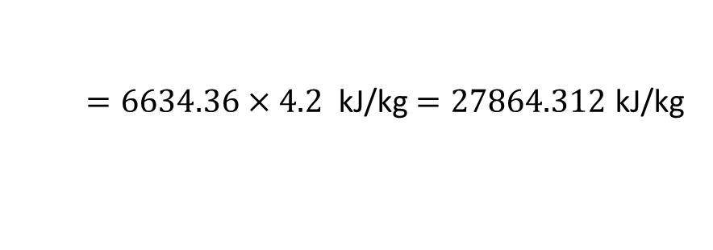
Problem
Q1. 2 kg of a fuel sample upon burning in a calorimeter, liberated 14114 kcal of heat. Calculate the calorific value of the fuel. Please note that the fuel contains 8% of hydrogen. Give your answer in kJ/kg.
Solution: here $m=$2 kg, $θ=$14114 kcal
$Calorific value$ = $\frac{14114}{2}$ kcal/kg = 7057 kcal/kg
$LCV=HCV−0.09H×587$kcal/kg
$=7057−\left(0.09×8×587\right)$ kcal/kg
$=6634.36$ $×4.2$ kJ/kg $=27864.312$ kJ/kg

Slide 17
Determination of Calorific value
Determination of calorific value of solid and non-volatile liquid fuels:
It is determined by bomb calorimeter
Principle:
A known amount of the fuel is burnt …
in excess of oxygen and …
heat liberated is transferred to a known amount of water.
The calorific value of the fuel is then determined by applying the principle of calorimetry i.e.
Heat gained = Heat lost

Slide 18
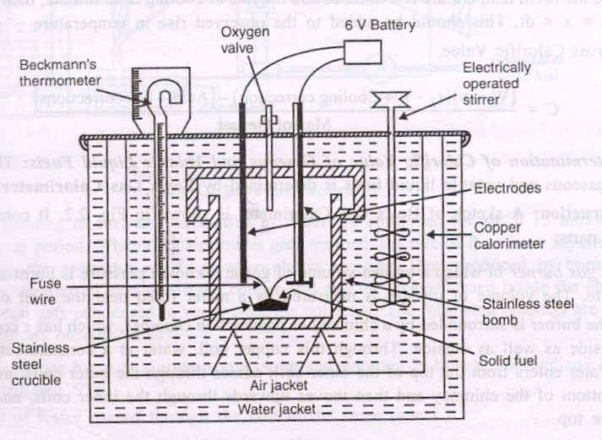
Bomb Calorimeter – Water equivalent

Slide 19

Determination of Calorific value
1. Bomb calorimeter
Determination of calorific value of solid and non volatile liquid fuels
Principle: A known mass of the solid sample is burnt in excess oxygen. The surrounding water and the calorimeter absorb the heat liberated. Thus the heat liberated by the fuel is equal to the heat absorbed by the water and the calorimeter.
Construction: The bomb calorimeter consists of a stainless steel vessel with an airtight lid. This vessel is called bomb. The bomb has an inlet valve for providing oxygen atmosphere inside the bomb and an electrical ignition coil for starting of combustion of fuel. The bomb is placed in an insulated copper calorimeter. The calorimeter has a mechanical stirrer for dissipation of heat and a thermometer for reading the temperature.
Working: A known mass of the solid fuel is placed in a crucible. The crucible is placed inside the bomb. The lid is closed tightly. The bomb is placed inside a copper calorimeter. A known mass of water is taken in the calorimeter. The bomb is filled with oxygen at a pressure of 25-30 atm. The temperature t₁ in the thermometer is noted. On passing an electric current through the ignition coil, the fuel gets ignited. The fuel burns liberating heat. The water is continuously stirred using the stirrer. The maximum temperature attained by the water, t₂ , is noted.

Slide 20
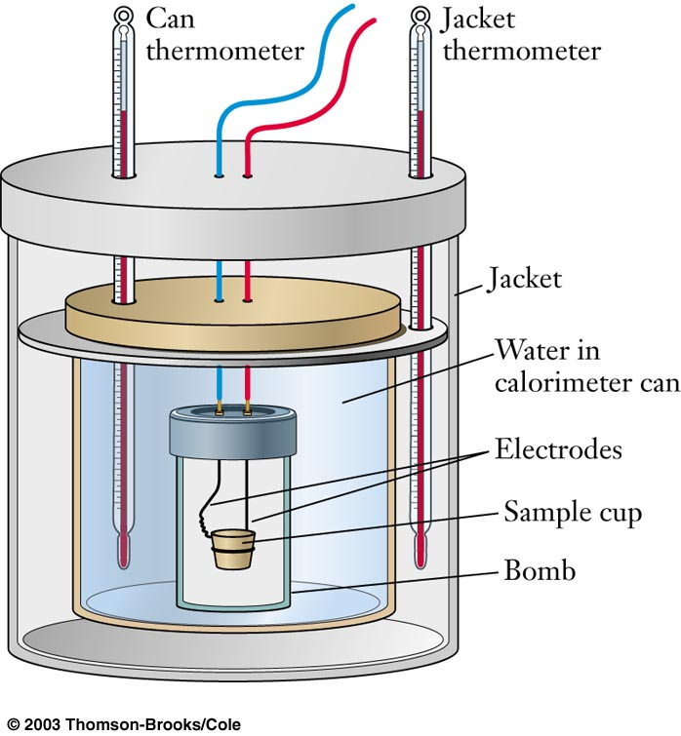

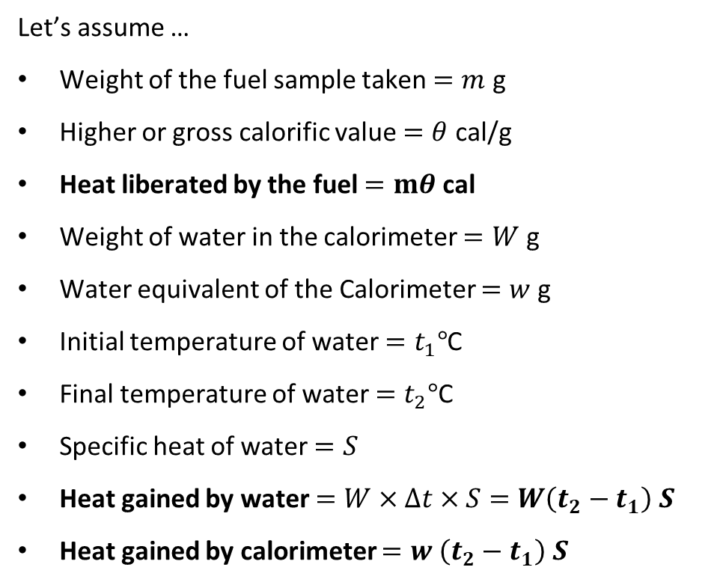
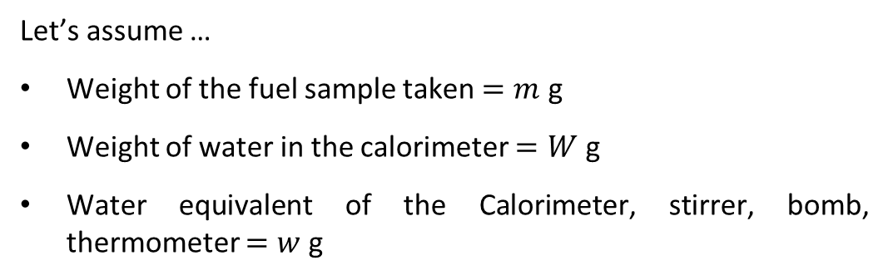
Bomb Calorimeter
Let’s assume …
Weight of the fuel sample taken $=m$ g
Weight of water in the calorimeter $=W$ g
Water equivalent of the Calorimeter, stirrer, bomb, thermometer $=w$ g
Let’s assume …
Weight of the fuel sample taken $=m$ g
Higher or gross calorific value $=θ$ cal/g
Heat liberated by the fuel $=mθ$ cal
Weight of water in the calorimeter $=W$ g
Water equivalent of the Calorimeter $=w$ g
Initial temperature of water $=t_{1}°$C
Final temperature of water $=t_{2}°$C
Specific heat of water $=S$
Heat gained by water $=W×Δt×S=W\left(t_{2}−t_{1}\right) S$
Heat gained by calorimeter $=w \left(t_{2}−t_{1}\right) S$
British Thermal Unit
Heat liberated by the fuel = Heat gained by water and calorimeter
$mθ$ = $(W+w)\left(t_{2}−t_{1}\right) S$ (cal
$θ$ = $\frac{\left(W+w\right)\left(t_{2}−t_{1}\right)S}{m}$ (cal/g)

Slide 21

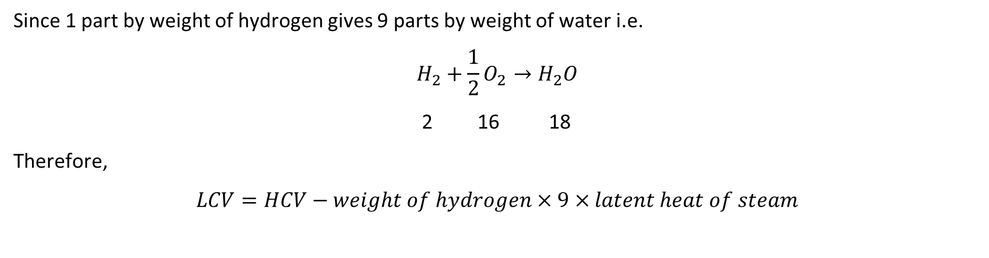
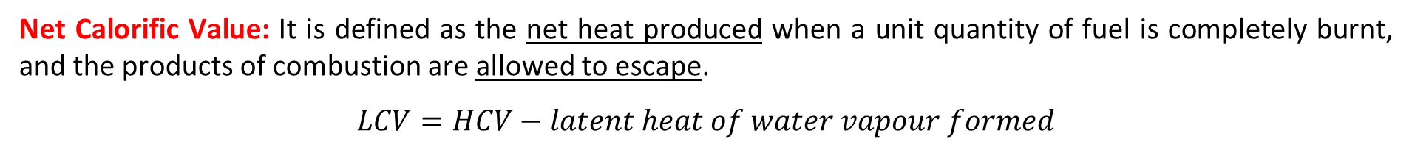
Gross and Net calorific Value
Net Calorific Value: It is defined as the net heat produced when a unit quantity of fuel is completely burnt, and the products of combustion are allowed to escape.
$$LCV=HCV−latent heat of water vapour formed$$
Since 1 part by weight of hydrogen gives 9 parts by weight of water i.e.
$$H_{2}+\frac{1}{2}O_{2}→H_{2}O$$
2 16 18
Therefore,
$$LCV=HCV−weight of hydrogen×9×latent heat of steam$$
$$=HCV−weight of hydrogen×9×587$$
$=HCV−0.09H×587 cal$ (in percentage)

Slide 22
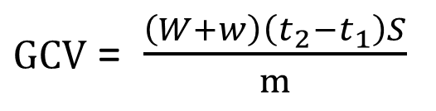
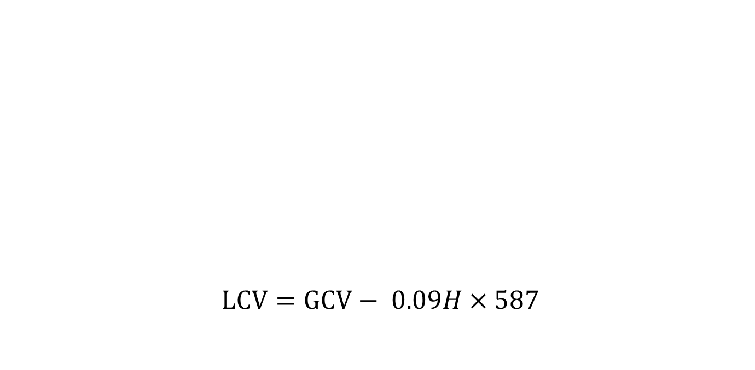
Bomb calorimeter
$LCV=GCV− 0.09H×587$
Gross calorific value
$GCV$ = $\frac{\left(W+w\right)\left(t_{2}−t_{1}\right)S}{m}$
Net calorific value

Slide 23
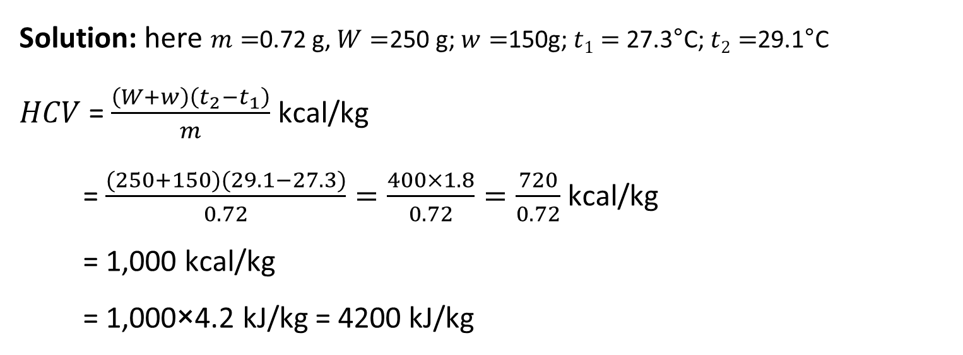
Q1. 0.72 gram of a fuel containing 80% carbon, when burnt in a bomb calorimeter, increased the temperature of water from 27.3°C to 29.1°C. If the calorimeter contains 250 g of water and its water equivalent is 150 g, calculate the calorific of the fuel. Give your answer in kJ/kg.
Solution: here $m=$0.72 g, $W=$250 g; $w=$150g; $t1=$27.3°C; $t2=$29.1°C
$HCV$ = $\frac{\left(W+w\right)\left(t_{2}−t_{1}\right)}{m}$ kcal/kg
= $\frac{(250+150)(29.1−27.3)}{0.72}=\frac{400×1.8}{0.72}=\frac{720}{0.72}$ kcal/kg
= 1,000 kcal/kg
= 1,000×4.2 kJ/kg = 4200 kJ/kg

Slide 24
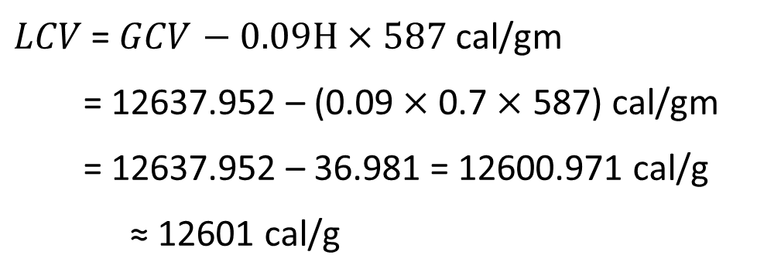
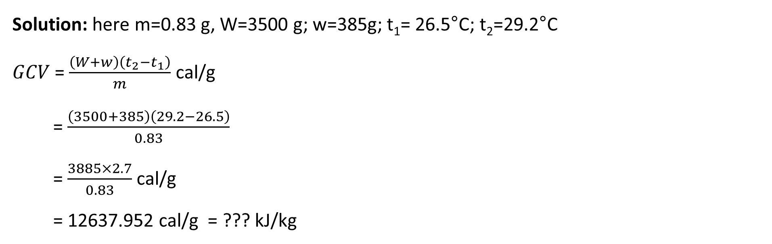
Q2. On burning 0.83 gram of a solid fuel in a bomb calorimeter, the temperature of 3500 g water increases from 26.5˚C to 29.2˚C. Water equivalent of the calorimeter and latent heat of steam is 385 g and 587 cal/g respectively. If the fuel contains 0.7% hydrogen, calculate the gross and net calorific value.
Solution: here m=0.83 g, W=3500 g; w=385g; t₁= 26.5°C; t₂=29.2°C
$GCV$ = $\frac{\left(W+w\right)\left(t_{2}−t_{1}\right)}{m}$ cal/g
= $\frac{\left(3500+385\right)\left(29.2−26.5\right)}{0.83}$
= $\frac{3885×2.7}{0.83}$ cal/g
= 12637.952 cal/g = ??? kJ/kg
$LCV$ = $GCV$ $− 0.09H×587$cal/gm
= 12637.952 – (0.09 $×$0.7$×$ 587) cal/gm
= 12637.952 – 36.981 = 12600.971 cal/g
≈ 12601 cal/g

Slide 25
Corrections
For accurate results, the following corrections are also incorporated:
Fuse wire correction: As Mg wire is used for ignition, the heat generated by burning of Mg wire is also included in the gross calorific value. Hence this amount of heat has to be subtracted from the total value.

Slide 26
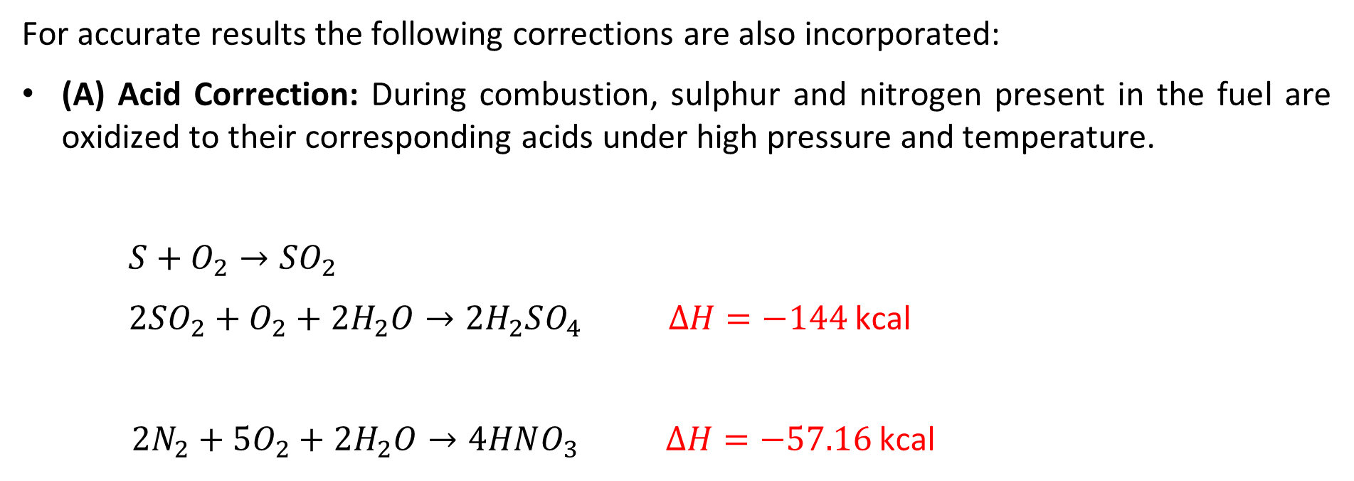
Corrections
For accurate results the following corrections are also incorporated:
(A) Acid Correction: During combustion, sulphur and nitrogen present in the fuel are oxidized to their corresponding acids under high pressure and temperature.
$S+O_{2}→SO_{2}$
$2SO_{2}+O_{2}+2H_{2}O→2H_{2}SO_{4} ΔH=−144$ kcal
$2N_{2}+{5O}_{2}+2H_{2}O→4HNO_{3} ΔH=−57.16$ kcal

Slide 27
Corrections
For accurate results the following corrections are also incorporated:
(B) Acid Correction: During combustion, sulphur and nitrogen present in the fuel are oxidized to their corresponding acids under high pressure and temperature.
The corrections must be made for the heat liberated in the bomb by the formation of H₂SO₄ and HNO₃. The amount of H₂SO₄ and HNO₃ is analysed by washings of the calorimeter.
        For each ml of 0.1N H₂SO₄ formed, 3.6 calories should be subtracted.
        For each ml of 0.1N HNO₃ formed, 1.429 calories must be subtracted.

Slide 28
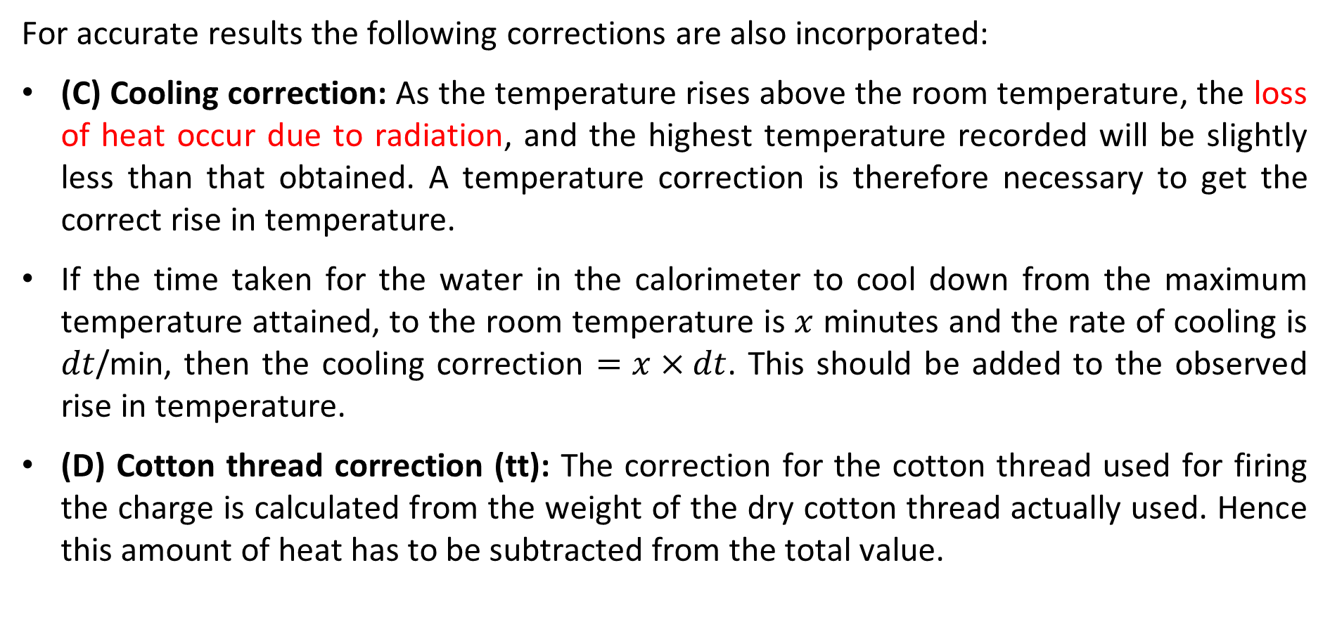
Corrections
For accurate results the following corrections are also incorporated:
(C) Cooling correction: As the temperature rises above the room temperature, the loss of heat occur due to radiation, and the highest temperature recorded will be slightly less than that obtained. A temperature correction is therefore necessary to get the correct rise in temperature.
If the time taken for the water in the calorimeter to cool down from the maximum temperature attained, to the room temperature is $x$ minutes and the rate of cooling is $dt$/min, then the cooling correction $=x×dt$. This should be added to the observed rise in temperature.
(D) Cotton thread correction (tt): The correction for the cotton thread used for firing the charge is calculated from the weight of the dry cotton thread actually used. Hence this amount of heat has to be subtracted from the total value.

Slide 29
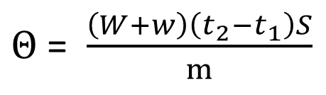
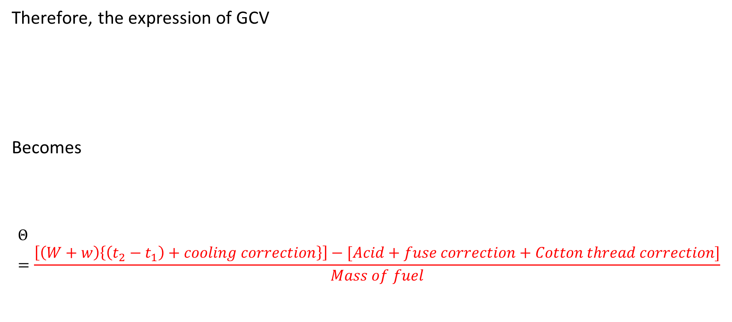
Gross calorific value
Therefore, the expression of GCV
Becomes
$$Θ=\frac{\left[\left(W+w\right)\left\{\left(t_{2}−t_{1}\right)+cooling correction\right\}\right]−[Acid+fuse correction+Cotton thread correction]}{Mass of fuel}$$
$Θ$ = $\frac{\left(W+w\right)\left(t_{2}−t_{1}\right)S}{m}$

Slide 30
Q3. A sample of coal contain C = 93%, H = 6% and ash = 1%. The following data were obtained when the above coal was tested in bomb calorimeter:
Weight of coal burnt = 0.92 g
Weight of water taken = 550 g
Water equivalent of bomb calorimeter = 2200 g
Rise in temperature = 2.42 ˚C
Fuse wire correction = 10 cal
Acid correction = 50 cal
Calculate gross and net calorific value. Assume that latent heat of vapour is s 580 cal/g.
$$Θ=\frac{\left(W+w\right)\{\left(t_{2}−t_{1}\right)+cooling correction\}−[Acid+fuse correction]}{Mass of fuel}$$
Solution: GCV = 7168.5 cal/g; LCV = 6855.3 cal/g

Slide 31
Q4. The following data is obtained in a bomb calorimeter:
Water taken = 700 g
Weight of crucible = 3.649 g
Weight of crucible and fuel = 4.678 g
Water equivalent of bomb calorimeter = 570 g
Rise in temperature = 2.3˚C
Fuse wire correction = 3.6 cal
Acid correction = 3.8 cal
Cooling correction = 0.05˚C
Calculate gross and net calorific value if the fuel contain 6.5% hydrogen
$$Θ=\frac{\left(W+w\right)\{\left(t_{2}−t_{1}\right)+cooling correction\}−[Acid+fuse correction]}{Mass of fuel}$$
Solution: GCV = 2893.2 cal/g; LCV = 2549.8 cal/g

Slide 32
Q5. Determine the water equivalent of the bomb calorimeter apparatus which gave the following data in the experiments:
Weight of Benzoic acid = 1.346 g
Weight of calorimeter = 1025 g
Weight of calorimeter and water = 3025 g
Initial temperature = 11.872˚C
Final Temperature = 14.625˚C
Cooling correction = 0.015˚C
Heat from fuses = 22 cal
Calorific value of benzoic acid = 6324 cal/g
$$Θ=\frac{\left(W+w\right)\{\left(t_{2}−t_{1}\right)+cooling correction\}−[Acid+fuse correction]}{Mass of fuel}$$
Solution: w= 1088.4 g

Slide 33
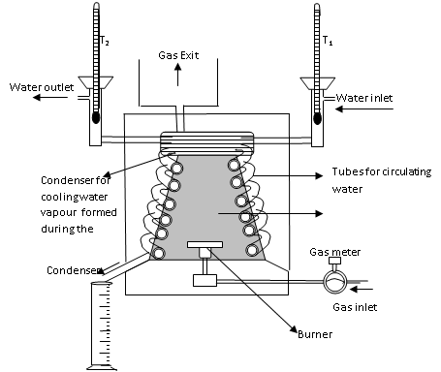
Boys Calorimeter
Used for measuring the calorific values of gaseous and liquid fuels (easily vaporizable)
APPARATUS: It consists of following –
Bunsen Burner: special type of Bunsen clamped at the bottom. It can be pulled out of the combustion chamber or pushed up in chamber during combustion.
Gasometer: It is employed to measure the volume of gas burning per unit time. This attached with manometer fitted with the thermometer so that pressure and temperature of the gas before burning can be read.
Pressure governor: It can control the supply of quantity of gas at given pressure.
Gas Calorimeter/ Combustion chamber: It is a vertical cylinder, which is surrounded by annular space for heating water and interchange coils. The entire system is covered by an outer jacket in order to reduce the heat loss by radiation and convection.

Slide 34
Boys Calorimeter
Used for measuring the calorific values of gaseous and liquid fuels (easily vaporizable)
Procedure:
Install the equipment on a flat rigid platform near an uninterrupted continuous water source of ½” size and a drainpipe.
Connect the gas source to the pressure regulator, gas flow meter and the burner respectively in series
Insert the thermometer/temperature sensors into their respective places to measure water inlet and outlet temperatures and a thermometer to measure the flue gas temperature at the flue gas outlet
Start the water flow through the calorimeter at a study constant flow rate and allow it to drain through overflow.
Start the gas flow slowly and light the burner outside the calorimeter

Slide 35
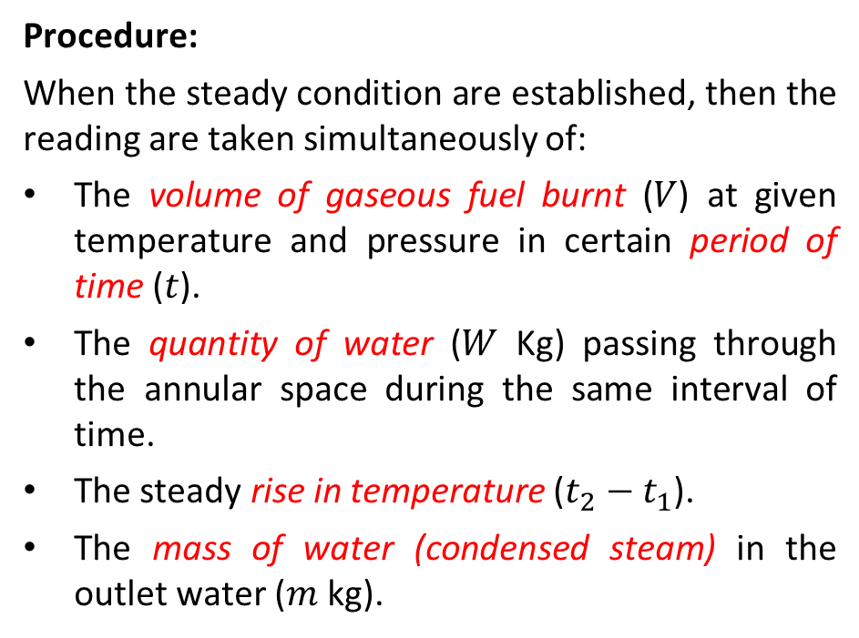
Boys Calorimeter
Used for measuring the calorific values of gaseous and liquid fuels (easily vaporizable)
Procedure:
When the steady condition are established, then the reading are taken simultaneously of:
The volume of gaseous fuel burnt ($V$) at given temperature and pressure in certain period of time ($t$).
The quantity of water ($W$ Kg) passing through the annular space during the same interval of time.
The steady rise in temperature ($t_{2}−t_{1}$).
The mass of water (condensed steam) in the outlet water ($m$kg).

Slide 36
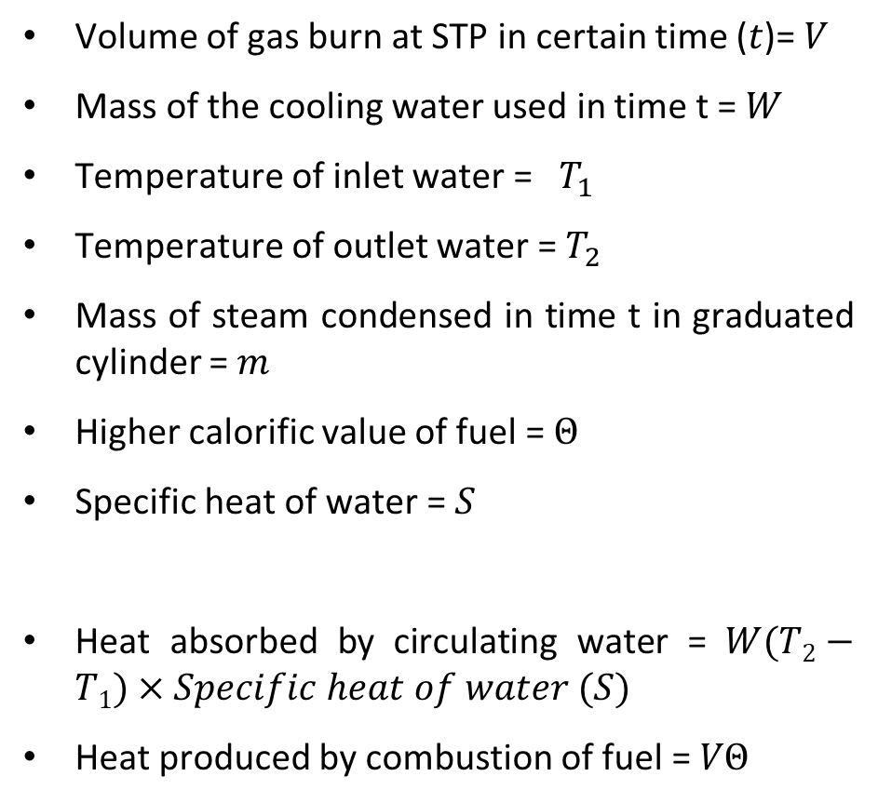
Boys Calorimeter
Volume of gas burn at STP in certain time ($t$)= $V$
Mass of the cooling water used in time t = $W$
Temperature of inlet water = $T_{1}$
Temperature of outlet water = $T_{2}$
Mass of steam condensed in time t in graduated cylinder = $m$
Higher calorific value of fuel = $Θ$
Specific heat of water = $S$
Heat absorbed by circulating water = $W(T2−T1)×Specific heat of water (S)$
Heat produced by combustion of fuel = $VΘ$
Procedure:
When the steady condition are established, then the reading are taken simultaneously of:
The volume of gaseous fuel burnt ($V$) at given temperature and pressure in certain period of time ($t$).
The quantity of water ($W$ Kg) passing through the annular space during the same interval of time.
The steady rise in temperature ($t_{2}−t_{1}$).
The mass of water (condensed steam) in the outlet water ($m$kg).

Slide 37
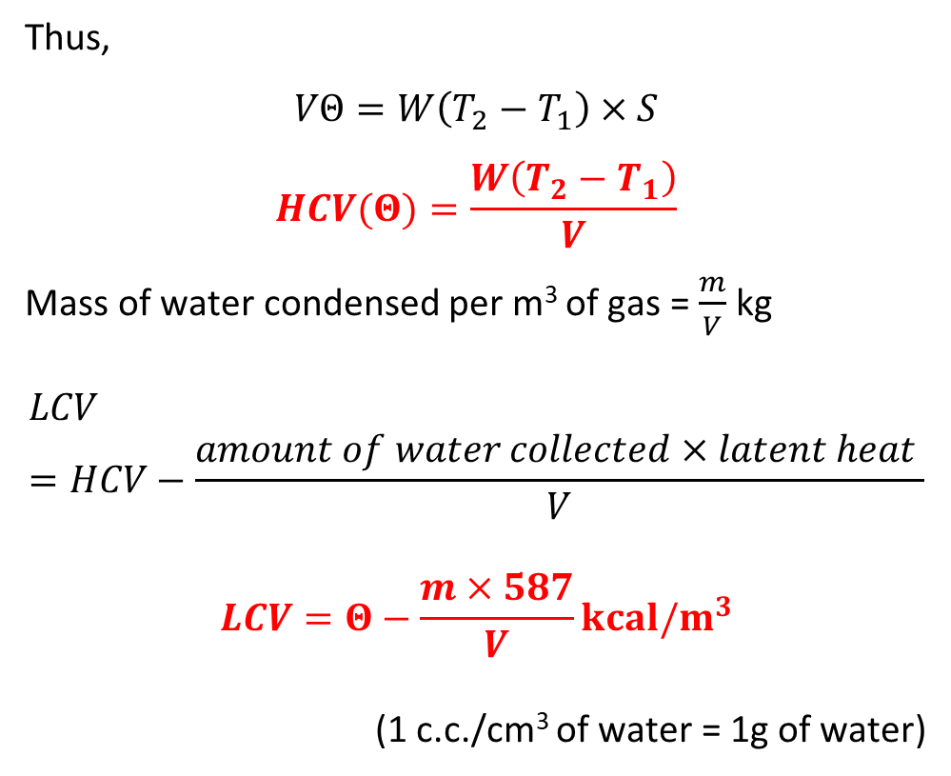
Boys Calorimeter
Thus,
$$VΘ=W\left(T_{2}−T_{1}\right)×S$$
$$HCV(Θ)=\frac{W\left(T_{2}−T_{1}\right)}{V}$$
Mass of water condensed per m³ of gas = $\frac{m}{V}$ kg
$$LCV=HCV−\frac{amount of water collected×latent heat }{V}$$
$$LCV=Θ−\frac{m×587}{V}kcal/m^{3}$$
(1 c.c./cm³ of water = 1g of water)

Slide 38

Boys Calorimeter
Volume of gas burn at STP in certain time ($t$)= $V$
Mass of the cooling water used in time t = $W$
Temperature of inlet water = $T_{1}$
Temperature of outlet water = $T_{2}$
Mass of steam condensed in time t in graduated cylinder = $m$
Higher calorific value of fuel = $Θ$
Specific heat of water = $S$
Heat absorbed by circulating water = $W(T2−T1)×Specific heat of water (S)$
Heat produced by combustion of fuel = $VΘ$
Thus,
$$VΘ=W\left(T_{2}−T_{1}\right)×S$$
$$HCV(Θ)=\frac{W\left(T_{2}−T_{1}\right) }{V}$$
Mass of water condensed per m³ of gas = $\frac{m}{V}$ kg
$$LCV=HCV−\frac{amount of water collected×latent heat }{V}$$
$$LCV=Θ−\frac{m×587}{V}kcal/m^{3}$$
(1 c.c./cm³ of water = 1g of water)

Slide 39
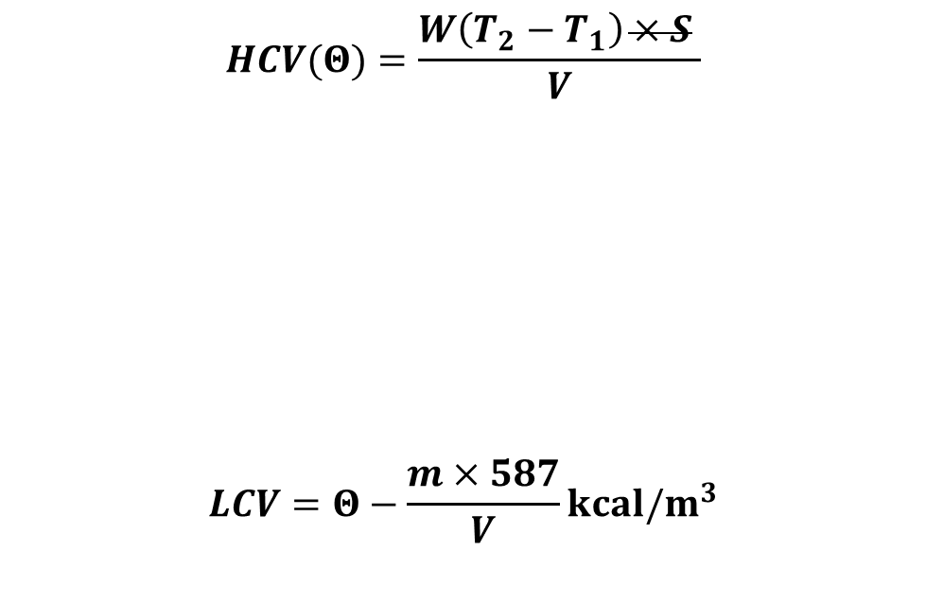
Q1. The following data is obtained in a Boy’s calorimeter:
Volume of gas used = 0.1 m³ at NTP
Weight of water heated = 25 kg
Temp. of inlet water = 20˚C
Temp. of outlet water = 33˚C
Weight of steam condensed = 0.025 kg
Calculate the gross and net calorific value per m³ at NTP. Take the heat liberated in condensing water is 580 kcal/kg
Calculate gross and net calorific value if the fuel contain 9.5% hydrogen
$$HCV(Θ)=\frac{W\left(T_{2}−T_{1}\right)×S }{V}$$
$$LCV=Θ−\frac{m×587}{V}kcal/m^{3}$$
Solution: GCV = 3250 kcal/m³; LCV = 3105 kcal/m³

Slide 40
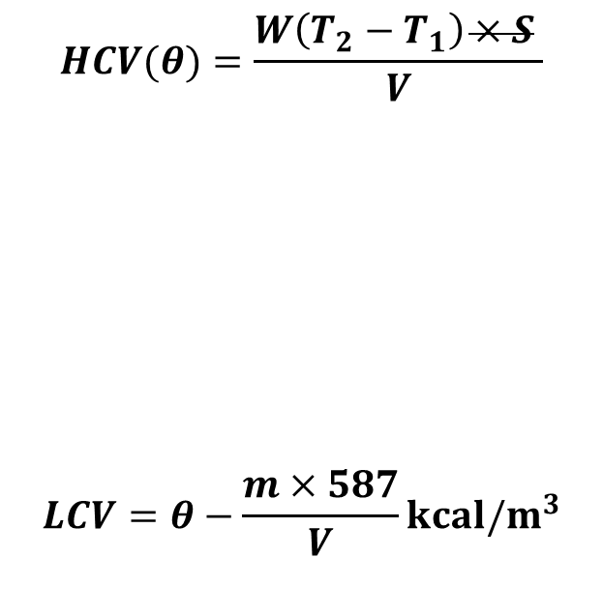
Q2. During the determination of calorific value of a gaseous fuel by Boy’s Calorimeter. The following results are obtained:
Vol. of gaseous fuel burnt at NTP = 0.093 m³
Weight of water used for cooling the combustion products = 30.5 kg
Weight of steam condensed = 0.031 kg
Temp. of inlet water = 26.1˚C
Temp. of outlet water = 36.5˚C
Determine the gross and net calorific value of the gaseous fuel per cubic meter at NTP provided that the heat liberated in condensation of water vapor is 587 kcal/kg
$$HCV(θ)=\frac{W\left(T_{2}−T_{1}\right)×S }{V}$$
$$LCV=θ−\frac{m×587}{V}kcal/m^{3}$$
Solution: GCV= 3410.75 kcal/m³; NCV= 3215.08 kcal/m³

Slide 41
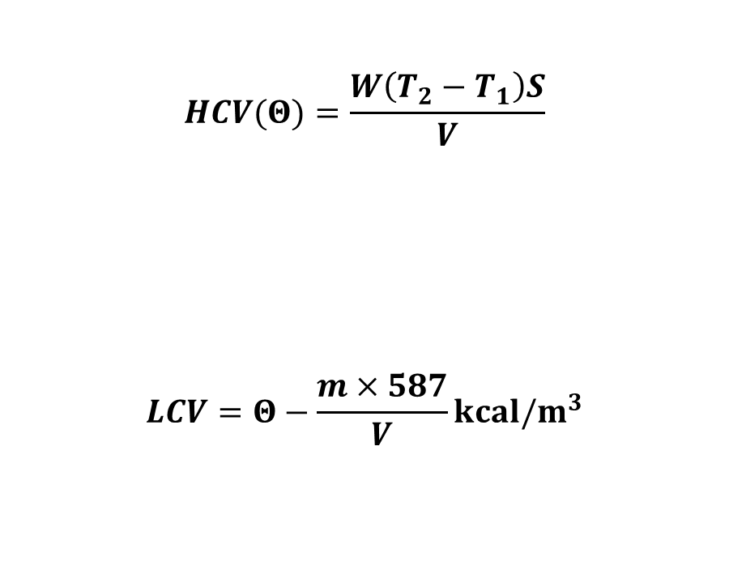
Q3. Calculate the gross calorific value and net calorific value of a gaseous fuel, 0.015m³ of which when burnt raised the temperature of 3.5 kg of water by 8.2K. Specific heat of water is 4.2 kJ kg⁻¹K⁻¹. Latent heat of steam is 2.45 kJ kg⁻¹. The volume of water collected is 6.5cm³
V = volume of the gas burnt = 0.015 m³
W = mass of water = 3.5 kg
t₂- t₁ = rise in temperature = 8.2 K
s = specific heat of water = 4.2kJ kg⁻¹K⁻¹
v = volume of water collected = 6.5 cm³
$$HCV(Θ)=\frac{W\left(T_{2}−T_{1}\right)S}{V}$$
$$LCV=Θ−\frac{m×587}{V}kcal/m^{3}$$

Slide 42
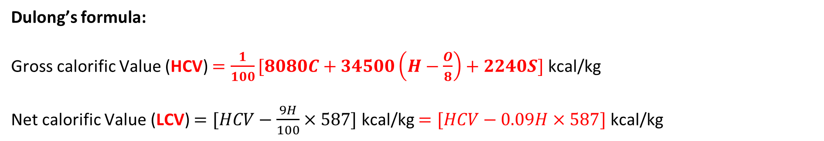
Theoretical calculation of Calorific value of a Fuel
Dulong’s formula
The calorific value of a fuel can be calculated if the percentages of the constituent elements are known.
Substrate | Calorific value (cal/g)
Carbon | 8080
Hydrogen | 34500
Sulphur | 2240
Dulong’s formula:
Gross calorific Value (HCV) $=\frac{1}{100}[8080C+34500\left(H−\frac{O}{8}\right)+2240S]$ kcal/kg
Net calorific Value (LCV) $=[HCV−\frac{9H}{100}×587]$ kcal/kg $=[HCV−0.09H×587]$ kcal/kg

Slide 43
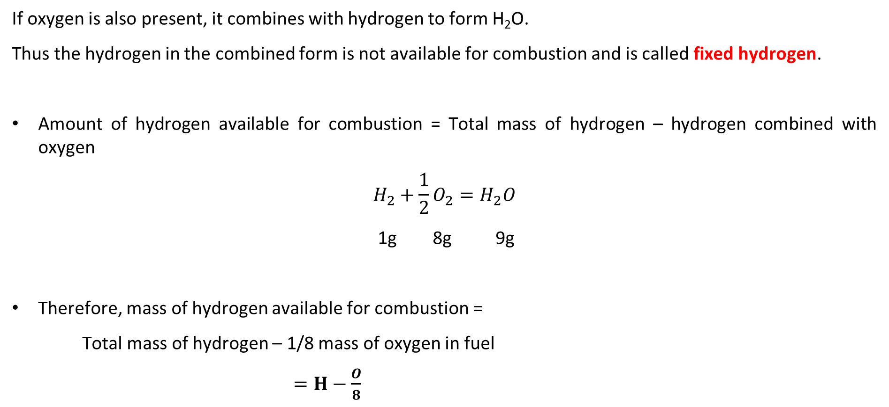
Fixed hydrogen
If oxygen is also present, it combines with hydrogen to form H₂O.
Thus the hydrogen in the combined form is not available for combustion and is called fixed hydrogen.
Amount of hydrogen available for combustion = Total mass of hydrogen – hydrogen combined with oxygen
$$H_{2}+\frac{1}{2}O_{2}=H_{2}O$$
1g 8g 9g
Therefore, mass of hydrogen available for combustion =
Total mass of hydrogen – 1/8 mass of oxygen in fuel
$=H−\frac{O}{8}$

Slide 44
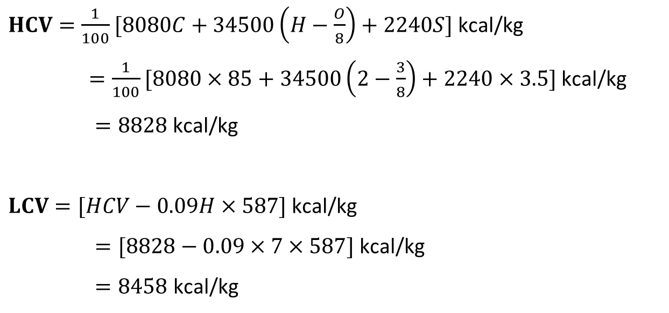
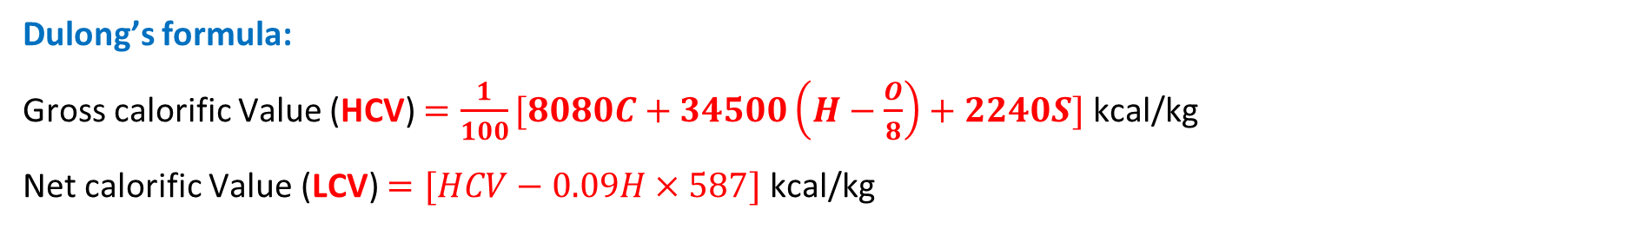
Dulong’s formula:
Gross calorific Value (HCV) $=\frac{1}{100}[8080C+34500\left(H−\frac{O}{8}\right)+2240S]$ kcal/kg
Net calorific Value (LCV) $=[HCV−0.09H×587]$ kcal/kg
Q1. Calculate the gross and net calorific value of coal having the following composition carbon = 80%, hydrogen = 7%, sulphur = 3.5%, nitrogen = 2.1%, oxygen =3%, Ash = 4.4 %.
$HCV=\frac{1}{100}[8080C+34500\left(H−\frac{O}{8}\right)+2240S]$ kcal/kg
$=\frac{1}{100}[8080×85+34500\left(2−\frac{3}{8}\right)+2240×3.5]$ kcal/kg
$=8828$kcal/kg
$LCV=[HCV−0.09H×587]$ kcal/kg
$=[8828−0.09×7×587]$ kcal/kg
$=8458$ kcal/kg

Slide 45
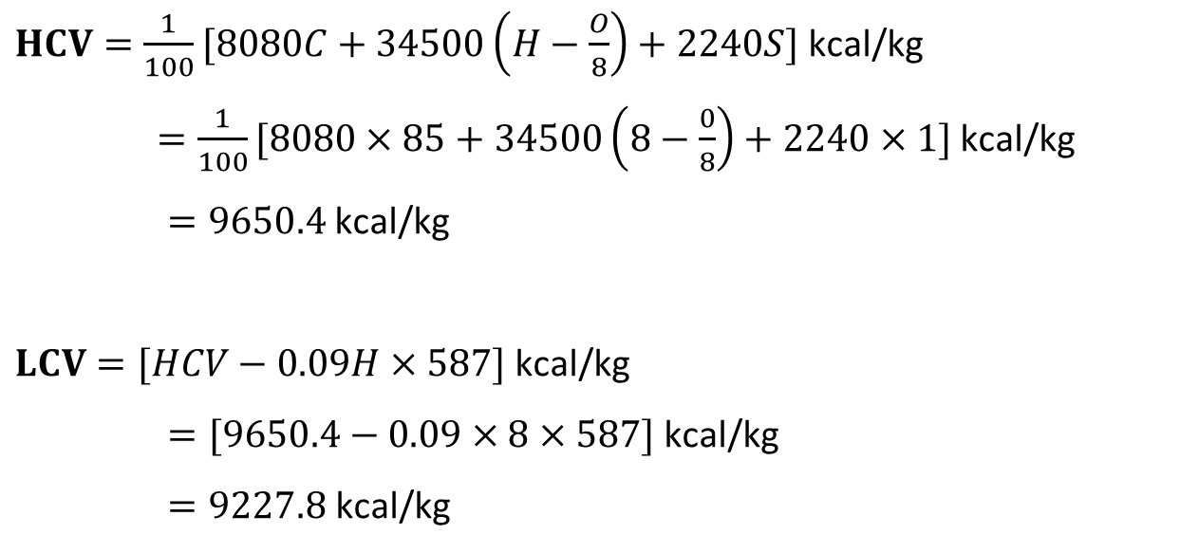
Q2. Calculate the gross and net calorific value of coal having the following composition carbon = 85%, hydrogen = 8%, sulphur = 1%, nitrogen = 2%, Ash = 4.0 %.
Latent heat of steam= 587 cal/g
$HCV=\frac{1}{100}[8080C+34500\left(H−\frac{O}{8}\right)+2240S]$ kcal/kg
$=\frac{1}{100}[8080×85+34500\left(8−\frac{0}{8}\right)+2240×1]$ kcal/kg
$=9650.4$kcal/kg
$LCV=[HCV−0.09H×587]$ kcal/kg
$=[9650.4−0.09×8×587]$ kcal/kg
$=9227.8$ kcal/kg

Slide 46
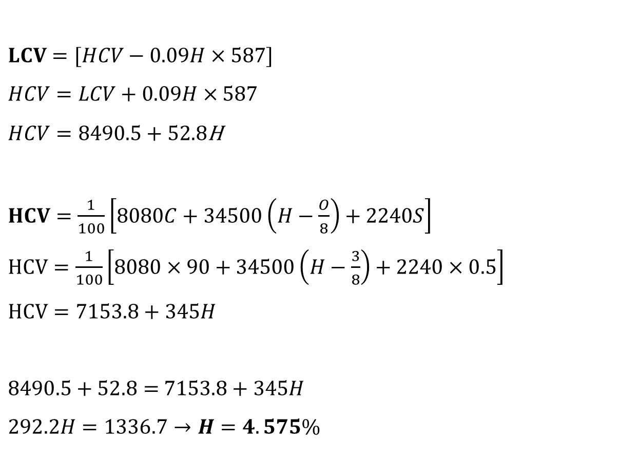
Q3. A coal has the following composition by mass : C=90%; O=3%; S=0.5%; N=0.5% and ash=2.5%. NCV= 8490.5kcal/kg. Calculate % of H and HCV.
$LCV=[HCV−0.09H×587]$
$HCV=LCV+0.09H×587$
$HCV=8490.5+52.8$H
$HCV=\frac{1}{100}\left[8080C+34500\left(H−\frac{O}{8}\right)+2240S\right]$
$HCV=\frac{1}{100}\left[8080×90+34500\left(H−\frac{3}{8}\right)+2240×0.5\right]$
$HCV=7153.8+345H$
$8490.5+52.8=$ $7153.8+345H$
$292.2H=1336.7→H=4.575\%$
$$HCV=8490.5+241.56 = 8732.06$$

Slide 47
Analysis of Coal

Slide 48
Analysis of Coal
To assess the quality of coal, the following two types of analysis are made:
Proximate analysis (Data vary with procedure adopted; This analysis provides data for a general assessment of the quality and type of coal)
Ultimate analysis (Precise chemical procedure; This analysis provides data for a specific assessment of the chemical composition of the coal sample)
Proximate analysis of coal determines the –
Moisture content
Volatile matter content
Ash content
Fixed carbon content
Ultimate analysis of coal determines the –
Carbon content
Hydrogen content
Oxygen content
Nitrogen content
Sulphur content

Slide 49
Proximate Analysis
Proximate analysis of coal determines the –
Moisture content
Volatile matter content
Ash content
Fixed carbon content
It gives information about the practical utility of coal.

Slide 50
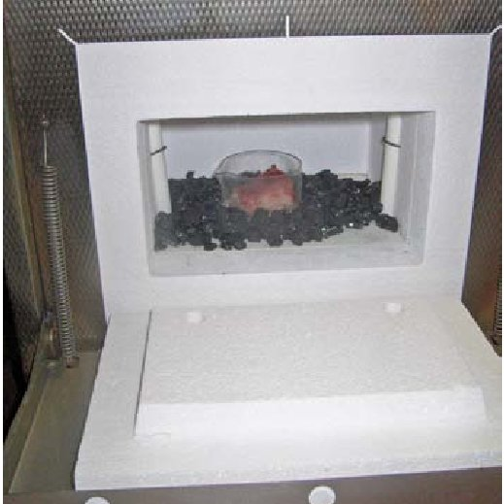
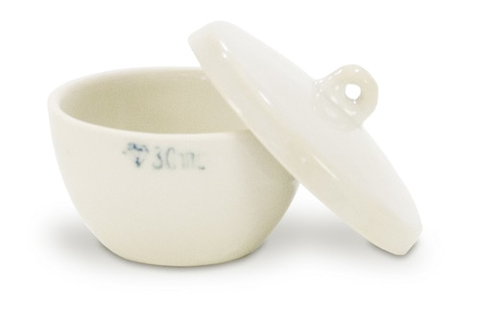
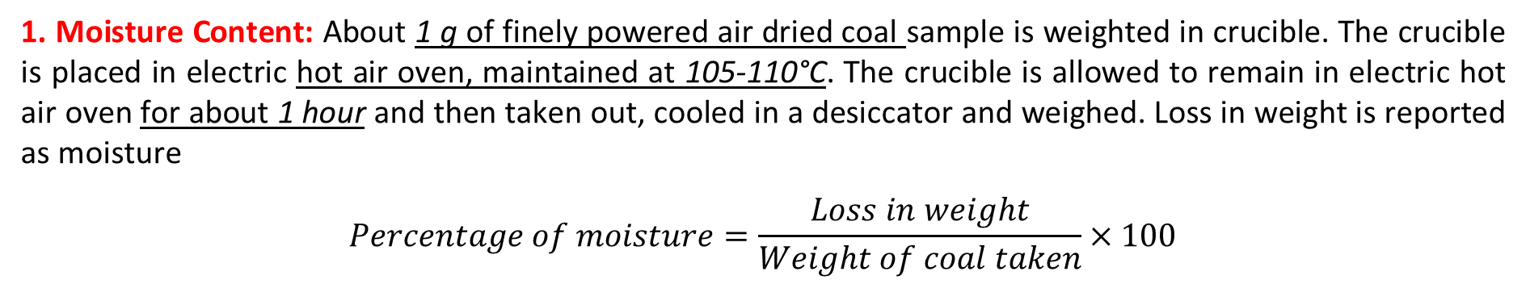
Proximate Analysis
1. Moisture Content: About 1 g of finely powered air dried coal sample is weighted in crucible. The crucible is placed in electric hot air oven, maintained at 105-110°C. The crucible is allowed to remain in electric hot air oven for about 1 hour and then taken out, cooled in a desiccator and weighed. Loss in weight is reported as moisture
$$Percentage of moisture=\frac{Loss in weight}{Weight of coal taken}×100$$

Slide 51
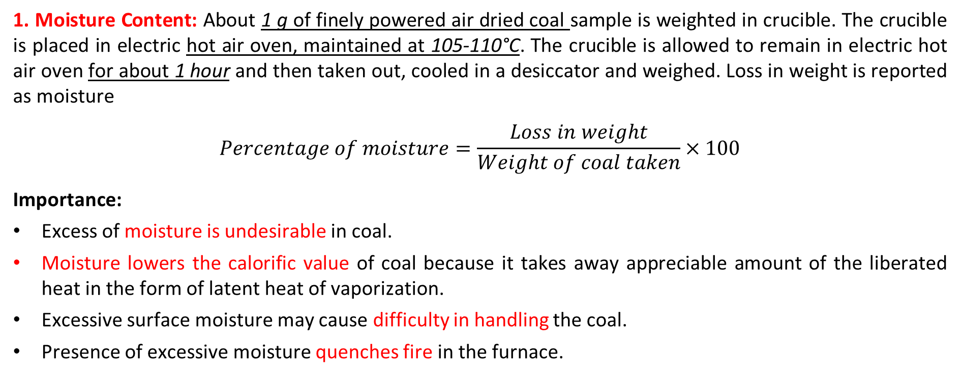
Proximate Analysis
1. Moisture Content: About 1 g of finely powered air dried coal sample is weighted in crucible. The crucible is placed in electric hot air oven, maintained at 105-110°C. The crucible is allowed to remain in electric hot air oven for about 1 hour and then taken out, cooled in a desiccator and weighed. Loss in weight is reported as moisture
$$Percentage of moisture=\frac{Loss in weight}{Weight of coal taken}×100$$
Importance:
Excess of moisture is undesirable in coal.
Moisture lowers the calorific value of coal because it takes away appreciable amount of the liberated heat in the form of latent heat of vaporization.
Excessive surface moisture may cause difficulty in handling the coal.
Presence of excessive moisture quenches fire in the furnace.

Slide 52
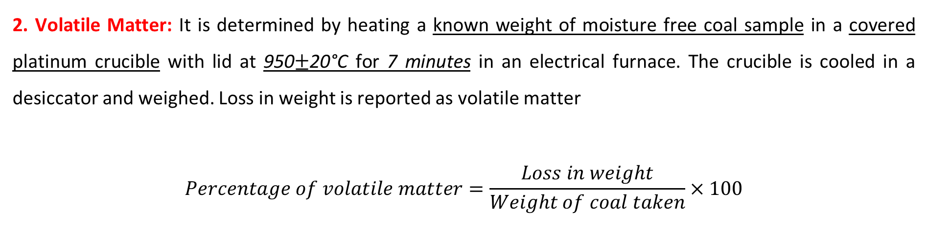
Proximate Analysis
2. Volatile Matter: It is determined by heating a known weight of moisture free coal sample in a covered platinum crucible with lid at 950$±$20°C for 7 minutes in an electrical furnace. The crucible is cooled in a desiccator and weighed. Loss in weight is reported as volatile matter
$$Percentage of volatile matter=\frac{Loss in weight}{Weight of coal taken}×100$$
Importance:
A high percent of volatile matter indicates that a large proportion of fuel is burnt as a gas.
The high volatile content gives long flames, high smoke and relatively low heating values.
For efficient use of fuel, the outgoing combustible gases has to be burnt by supplying secondary air.
High volatile matter content is desirable in the manufacture of coal gas because volatile matter in coal denotes the proportion of the coal which will be converted into gas and tar products by heat.

Slide 53
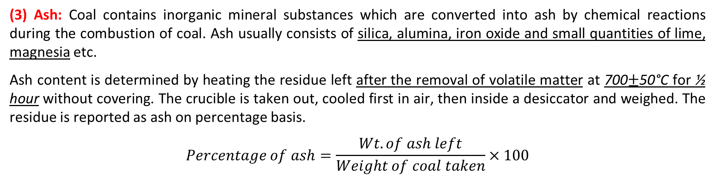
Proximate Analysis
(3) Ash: Coal contains inorganic mineral substances which are converted into ash by chemical reactions during the combustion of coal. Ash usually consists of silica, alumina, iron oxide and small quantities of lime, magnesia etc.
Ash content is determined by heating the residue left after the removal of volatile matter at 700$±$50°C for ½ hour without covering. The crucible is taken out, cooled first in air, then inside a desiccator and weighed. The residue is reported as ash on percentage basis.
$$Percentage of ash=\frac{Wt. of ash left}{Weight of coal taken}×100$$
Importance:
The high percentage of ash is undesirable. It reduces the calorific value of coal.
In furnace grate, the ash may restrict the passage of air and lower the rate of combustion.
High ash leads to large heat losses and leads to formation of ash lumps.
The composition of ash and fusion range also influences the efficiency of coal.

Slide 54
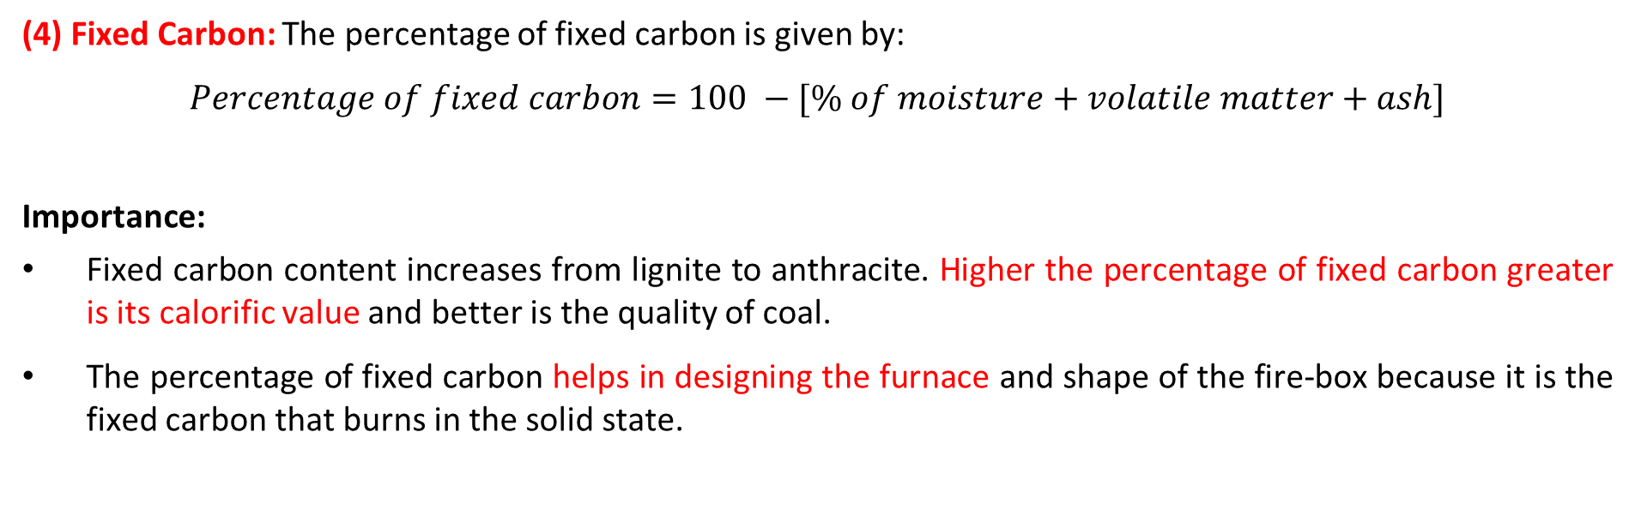
Proximate Analysis
(4) Fixed Carbon: The percentage of fixed carbon is given by:
$$Percentage of fixed carbon=100 −[\% of moisture+volatile matter+ash]$$
Importance:
Fixed carbon content increases from lignite to anthracite. Higher the percentage of fixed carbon greater is its calorific value and better is the quality of coal.
The percentage of fixed carbon helps in designing the furnace and shape of the fire-box because it is the fixed carbon that burns in the solid state.

Slide 55
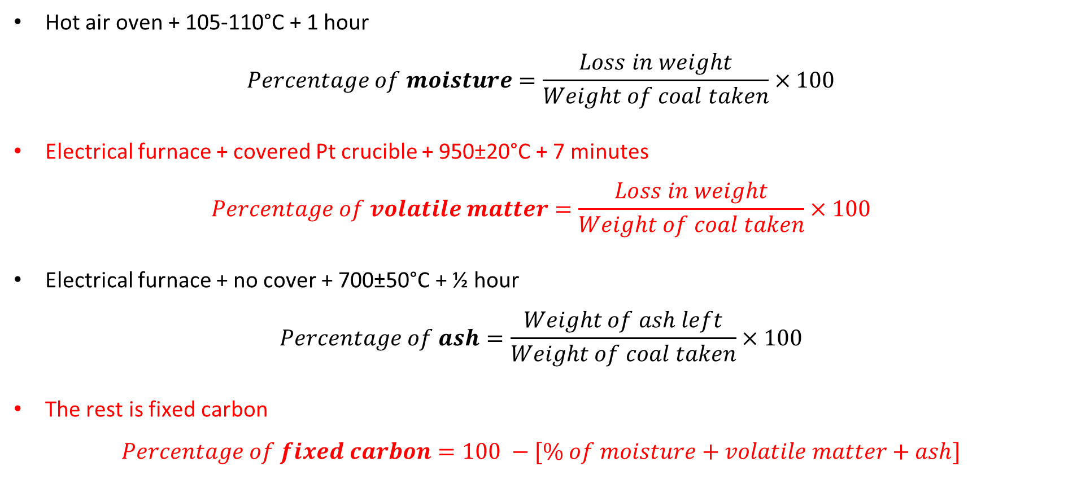
Proximate Analysis
Hot air oven + 105-110°C + 1 hour
$$Percentage of moisture=\frac{Loss in weight}{Weight of coal taken}×100$$
Electrical furnace + covered Pt crucible + 950±20°C + 7 minutes
$$Percentage of volatile matter=\frac{Loss in weight}{Weight of coal taken}×100$$
Electrical furnace + no cover + 700±50°C + ½ hour
$$Percentage of ash=\frac{Weight of ash left}{Weight of coal taken}×100$$
The rest is fixed carbon
$$Percentage of fixed carbon=100 −[\% of moisture+volatile matter+ash]$$

Slide 56
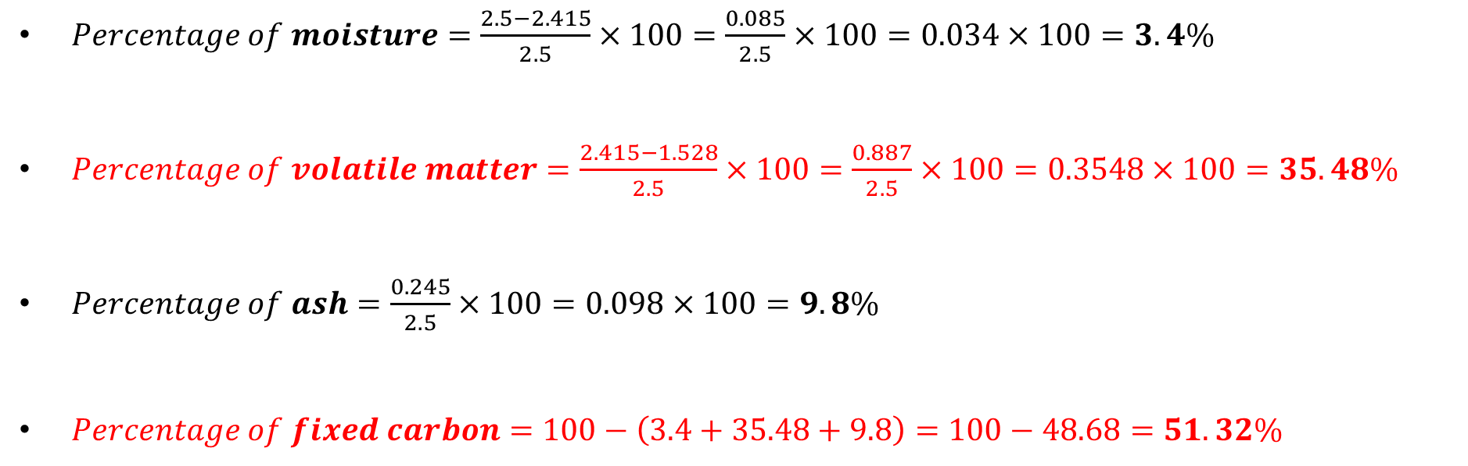
Proximate analysis
Q1. A sample of coal is analyzed as follows:
Exactly 2.5 g was weighted into silica crucible. After heating for an hour at 110˚C, the residue weighed 2.415g. The crucible next was covered with a vented lid and strongly heated for exactly 7 minutes at 950˚C. The residue weighed 1.528 g. The crucible was then heated without the cover, until a constant weight was obtained. The last residue was found to weigh 0.245 g. Calculate the percentage result of above analysis. What kind of analysis is this?
$Percentage of moisture=\frac{2.5−2.415}{2.5}×100=\frac{0.085}{2.5}×100=0.034×100=3.4\%$
$Percentage of volatile matter=\frac{2.415−1.528}{2.5}×100=\frac{0.887}{2.5}×100=0.3548×100=35.48\%$
$Percentage of ash=\frac{0.245}{2.5}×100=0.098×100=9.8\%$
$Percentage of fixed carbon=100−\left(3.4+35.48+9.8\right)=100−48.68=51.32\%$

Slide 57
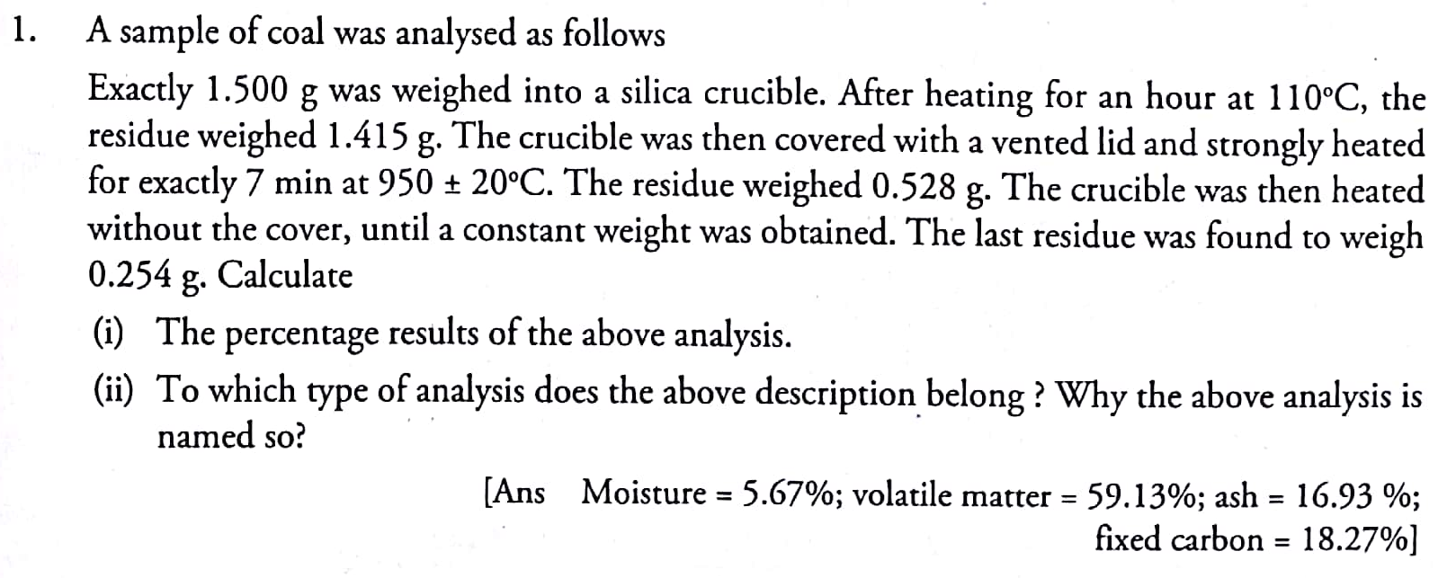
Proximate analysis

Slide 58
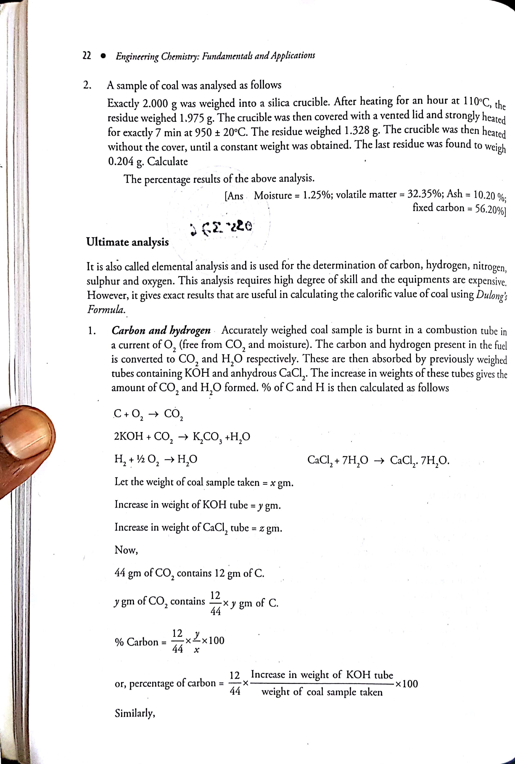
Proximate analysis

Slide 59
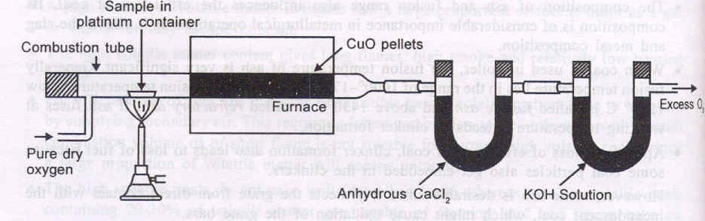
Analysis of Coal
Ultimate analysis
It is carried out to ascertain the composition of coal.
Ultimate analysis includes the estimation of carbon, hydrogen, sulphur, nitrogen and oxygen.
1. Carbon and Hydrogen: A known amount of coal is taken in a combustion tube and is burnt in excess of pure oxygen. C and H of coal are converted into CO₂ and H₂O respectively. Theses gaseous products are absorbed respectively in CaCl₂ and KOH tubes of known weight.

Slide 60

Analysis of Coal
Ultimate analysis
1. Carbon and Hydrogen:
$$C+O_{2}→CO_{2}$$
$$2KOH+CO_{2}→K_{2}CO_{3}+H_{2}O$$
$$H_{2}+\frac{1}{2}O_{2}→H_{2}O$$
$$CaCl_{2}+7H_{2}O→CaCl_{2}.7H_{2}O$$

Slide 61
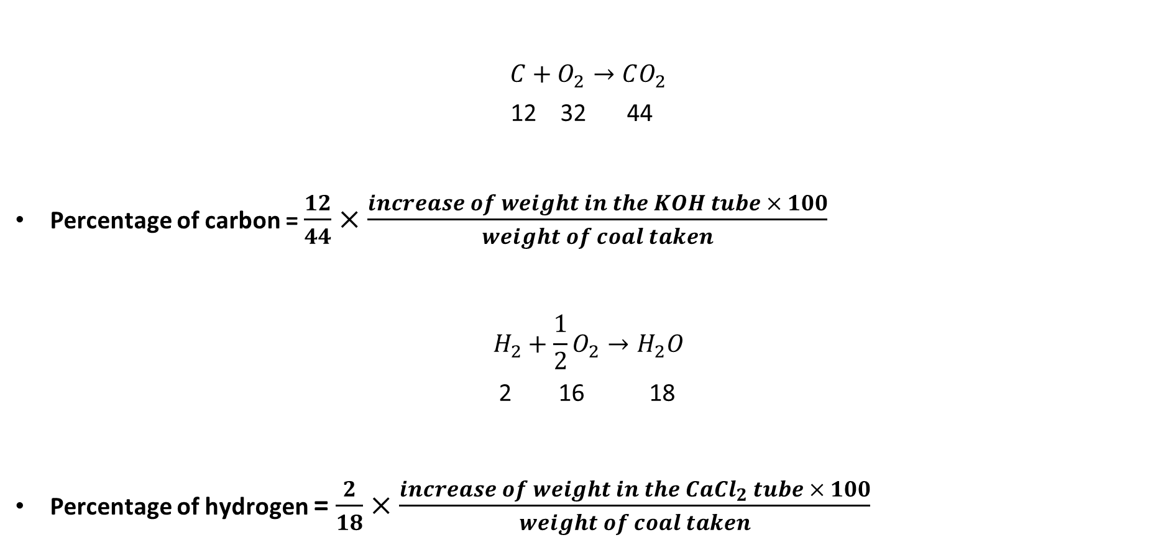
Analysis of Coal
Ultimate analysis
$$C+O_{2}→CO_{2}$$
12 32 44
Percentage of carbon = $\frac{12}{44}×\frac{increase of weight in the KOH tube × 100}{weight of coal taken}$
$$H_{2}+\frac{1}{2}O_{2}→H_{2}O$$
2 16 18
Percentage of hydrogen = $\frac{2}{18}×\frac{increase of weight in the CaCl_{2} tube × 100}{weight of coal taken}$
1. Carbon and Hydrogen:

Slide 62
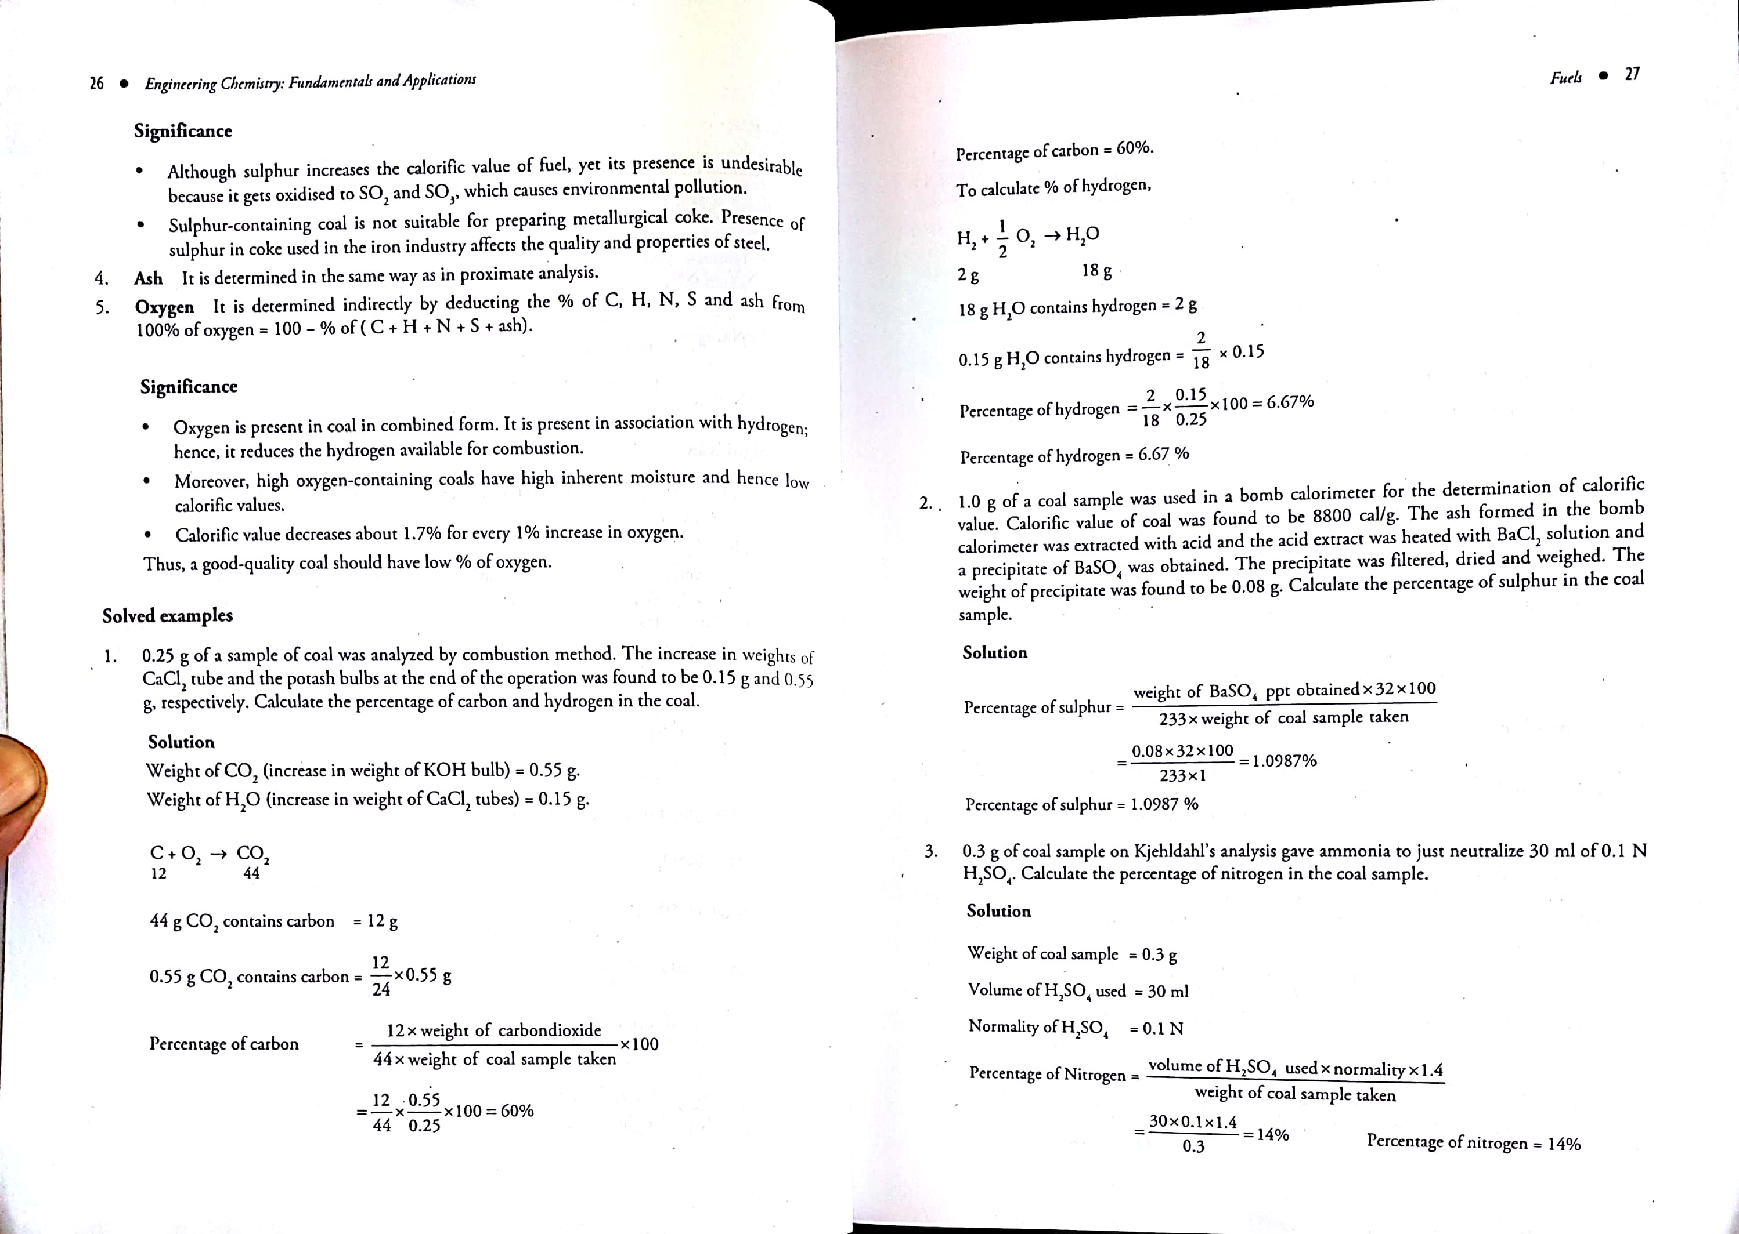
Ultimate analysis

Slide 63
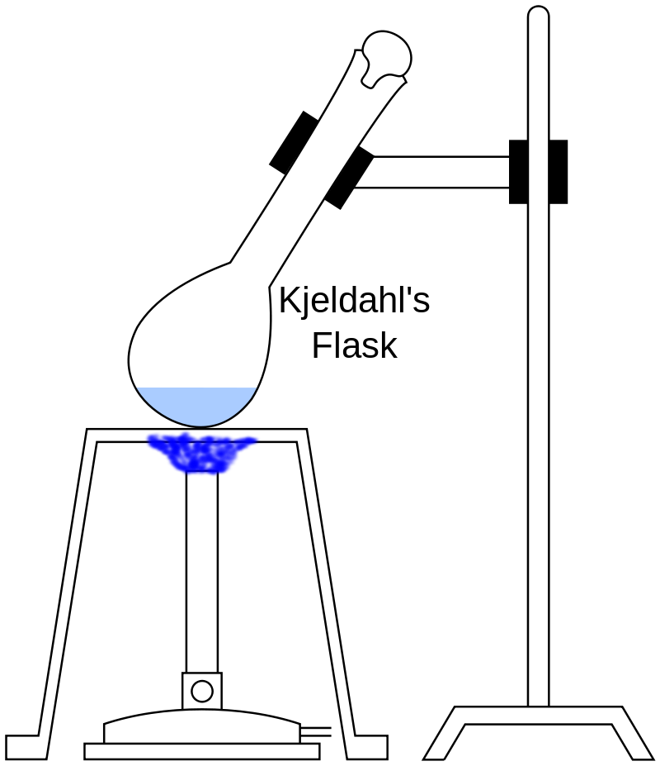

Ultimate analysis
2. Nitrogen: Nitrogen present in coal sample can be estimated by Kjeldahl’s method.
$$Nitrogen in fuel+H_{2}SO_{4}\underset{→}{Heat}{\left(NH_{4}\right)}_{2}SO_{4}$$

Slide 64


Ultimate analysis
2. Nitrogen: Nitrogen present in coal sample can be estimated by Kjeldahl’s method.
$$Nitrogen+H_{2}SO_{4}\underset{→}{Heat}{\left(NH_{4}\right)}_{2}SO_{4}$$
The contents are then transferred to a round bottomed flask and solution is heated with excess of NaOH.
$${\left(NH_{4}\right)}_{2}SO_{4}\underset{→}{2 NaOH}Na_{2}SO_{4}+2 NH_{3}+2 H_{2}O$$
The ammonia gas thus liberated is absorbed in a known volume of a standard solution of acid used.
$$NH_{3}+H_{2}{SO}_{4}→{\left({NH}_{4}\right)}_{2}{SO}_{4}$$

Slide 65

Ultimate analysis
2. Nitrogen: Nitrogen present in coal sample can be estimated by Kjeldahl’s method.
The unused acid is then determined by titrating with NaOH. From the volume of acid used by NH₃ liberated, the percentage of nitrogen can be calculated.
$Percentage of$N = $1.4×\frac{Volume of acid used×Normality}{Weight of coal taken}$

Slide 66

Ultimate analysis
Q3. 1.5 g of a sample of coal was used for nitrogen estimation by Kjeldahl method. The evolved ammonia was collected in 25mL of 0.1N sulfuric acid. To neutralize excess acid, 15 mL of N/10 sodium hydroxide was required. Determine the percentage of nitrogen in the given sample of coal.
$Percentage of$N = $1.4×\frac{Volume of acid used×Normality}{Weight of coal taken}$
$Total acid=25mL 0.1 N$
$Excess=15mL\frac{N}{10}=15mL 0.1N$
$NH_{3} consumed=\left(25−15\right)mL 0.1N=10mL 0.1N$
$Percentage of$N = $1.4×\frac{10×0.1}{1.5}$
$Percentage of$N = $0.933\%$

Slide 67



Slide 68

Ultimate analysis
Q4. 2 g of a sample of coal was used for nitrogen estimation by Kjeldahl method. The evolved ammonia was collected in 60 mL of 0.1 N sulfuric acid. To neutralize excess acid, 20 mL of 0.2 N sodium hydroxide was required. Determine the percentage of nitrogen in the given sample of coal.
$Percentage of$N = $1.4×\frac{Volume of acid used×Normality}{Weight of coal taken}$
Weight of coal sample: 2 g
Volume of acid (0.1 N H₂SO₄): 60 mL
The amount (volume) of excess acid (acid did not react with evolved ammonia) obtained by neutralization with 0.2 N NaOH soln.
$N_{1}V_{1}=N_{2}V_{2}⇒0.1×V_{1}=0.2×20⇒V_{1}=40mL$
The volume of acid reacted with evolved ammonia: (60-40) = 20 mL
$Percentage of$N = $1.4×\frac{20×0.1}{2}=1.4\%$

Slide 69
Ultimate analysis

Slide 70

Ultimate analysis

Slide 71

Ultimate analysis
3. Sulphur is determined conveniently from the bomb washing from combustion of a known mass of coal in bomb calorimeter experiment. The washing contain
Sulphur in the form of sulphate which it is precipitate as BaSO₄
$$S+O_{2}→SO_{2}$$
$$2SO_{2}+O_{2}+2H_{2}O→2H_{2}SO_{4}$$
$$H_{2}SO_{4}+BaCl_{2}→BaSO_{4}↓+2 HCl$$
$$Percentage of S=\frac{32}{233}×\frac{Weight of BaSO_{4}}{Weight of the whole sample taken in the bomb}×100$$
$233 g BaSO_{4} comes from 32 g sulphur$
$1 g BaSO_{4} comes from\frac{32}{233} g sulphur$
$x g BaSO_{4} comes from\frac{x×32}{233} g sulphur$

Slide 72

Ultimate analysis
Q2. 0.5g of a sample of coal was used in a bomb calorimeter for the determination of calorific value. The calorific value of coal was found to be 8600cal/g. The ash formed in the bomb calorimeter was extracted with HNO₃ and treated with barium nitrate solution and a precipitate of barium sulfate was obtained. The weight of BaSO₄ was found to be 0.05 g calculate the % of sulfur in coal sample.
$Percentage of$S = $\frac{Weight of BaSO_{4}×32×100}{Weight of the whole sample taken in the bomb×233}$
$Percentage of$S = $\frac{0.05×32×100}{0.5×233}$
$Percentage of$S = $\frac{160}{116.5}=1.37\%$

Slide 73

Ultimate analysis
Q5. A bomb calorimeter experiment with 1 g of coal sample yields H₂SO₄, which is equivalent to 15 mL 0.1 N NaOH solution. Calculate the heat associated to acid formation (acid correction) and determine the % of Sulphur in the coal sample.
(molecular weight of H₂SO₄ is 98 and atomic weight of Sulphur is 32)
$Percentage of$S = $\frac{Weight of BaSO_{4}×32×100}{Weight of the whole sample taken in the bomb×233}$
        For each ml of 0.1N H₂SO₄ formed, 3.6 calories should be subtracted.

Slide 74

Ultimate analysis
Q5. A bomb calorimeter experiment with 1 g of coal sample yields H₂SO₄, which is equivalent to 15 mL 0.1 N NaOH solution. Calculate the heat associated to acid formation (acid correction) and determine the % of Sulphur in the coal sample.
(molecular weight of H₂SO₄ is 98 and atomic weight of Sulphur is 32)
$1ml 0.1N H_{2}SO_{4}≡3.6 cal heat generation$
$15ml 0.1N H_{2}SO_{4}≡\left(3.6×15\right)cal heat generation$
  $$≡54 cal heat generation$$
  $1000ml 1M\left(or 2N\right)H_{2}SO_{4}≡98gH_{2}SO_{4}≡32g Sulphur$
  $1000ml 1N H_{2}SO_{4}≡\frac{32}{2}g Sulphur$
  $15ml 0.1N H_{2}SO_{4}≡\frac{32×15×0.1}{2×1000}g Sulphur=0.024g Sulphur$

Slide 75

Ultimate analysis
$Percentage of$C = $\frac{12}{44}×\frac{increase in weight of KOH tube ×100}{Weight of coal taken}$
$Percentage of$H = $\frac{2}{18}×\frac{increase in weight of CaCl_{2}tube×100}{Weight of coal taken}$
$Percentage of$N = $1.4×\frac{Volume of acid used×Normality}{Weight of coal taken}$
$Percentage of$S = $\frac{Weight of BaSO_{4}×32×100}{Weight of the whole sample taken in the bomb×233}$
$Percentage of$O = $100−percentage of (C+H+S+N+ash)$

Slide 76
LIQUID FUEL

Slide 77
Liquid Fuels:
The importance of liquid fuels is the fact that almost all combustion engines run on them.
The largest source of liquid fuels is petroleum.
There are other supplements of liquid fuels such as coal tar, crude benzol, syntheic liquid fuel made from coal etc.
Petroleum:
The term petroleum means rock oil (Latin words; petra = rock and oleum = oil). It is also called mineral oil.
Petroleum is a dark colored viscous liquid found deep in the earth’s crust and is a complex mixture of paraffinic, olefinic and aromatic hydrocarbons with small quantities of organic compounds containing oxygen, nitrogen and sulphur and traces of metallic constituents.

Slide 78
Composition:
Element | Carbon | Hydrogen | Sulphur | Oxygen | Nitrogen
Percentage | 80-87 | 11.1-15 | 0.1-3.5 | 0.1-0.9 | 0.4-0.9

Slide 79
The ash of the crude oil is 0.1%.Metals e.g., Silicon, iron, aluminium, calcium, magnesium, nickel and sodium.
Crude oil is a mixture of straight chain paraffins and aromatic hydrocarbons e.g., benzene, toluene, naphthalenes etc.
Sulphur is present in the form of derivatives of hydrocarbons such as alkylsulphides, aromatic sulphides etc. Nitrogen is present in the form of pyridine, quinoline derivatives, pyrrole etc.
Combined oxygen is present as carboxylic acids, ketones and phenols.
The objectionable odour of crude petroleum is due to the presence of sulphur compounds in it.

Slide 80
Classification of Crude Petroleum
Residue obtained after distillation | Name | Contents
Paraffin wax Asphalt Paraffin wax and asphalt | Paraffin base Asphaltic base Mixed base | Straight chain hydrocarbons; small amounts of naphthenes and aromatic hydrocarbons Aromatic and naphthenic hydrocarbons Paraffins, naphthenes and aromatic hydrocarbons

Slide 81

Petroleum is found deep below the earth crust. The oil is found floating over salt water or brine. Generally, accumulation of natural gas occurs above the oil.
Mining of Crude Petroleum:
Fig. Mining of oil

Slide 82
Refining of Petroleum
Steps involved in refining of petroleum:
Demulsification:
The crude oil coming out from the well, is in the form of stable emulsion of oil and salt water, which is yellow to dark brown in colour.
The demulsification is achieved by Cottrell’s process, in which the water is removed from the oil by electrical process.
The crude oil is subjected to an electrical field, when droplets of colloidal water unite to form large drops which separate out from the oil.
(ii) Removal of harmful impurities:
Excessive salt content such as NaCl and MgCl₂ can corrode the refining equipment. These are removed by washing with water.
The objectionable sulphur compound are removed by treating the oil with copper oxide. The copper sulphide so formed is separated by filtration.

Slide 83

(iii) Fractional Distillation:
It is done in tall fractionating tower or column made up of steel.
In continuous process, the crude oil is preheated to 400 ºC in specially designed tubular furnace known as pipe still.
Fig.: Fractional distillation of crude petroleum

Slide 84

The hot vapours from the crude are passed through a tall fractionating column, called bubble tower.
Bubble tower consists of horizontal trays provided with a number of small chimneys, through which vapours rise.
These chimneys are covered with loose caps, known as bubble caps. These bubble caps help to provide an intimate contact between the escaping vapours and down coming liquid.
The temperature in the fractionating tower decreases gradually on moving upwards.
As the vapours of the crude oil go up, they become gradually cooler and fractional condensation takes place at different heights of column.

Slide 85

The residue from the bottom of the fractionating tower is vacuum distilled to recover various fractions
Fig.: Vacuum distillation of residual oil

Slide 86
A brief description of the various fractions obtained by the fractionation of petroleum is given below:
Uncondensed gases: composition range is CH₄ to C₄H₁₀. Boiling range 0 to 30 ºC. It is used as a gaseous fuel.
Petroleum ether: Composition range is C₅H₁₂ to C₇H₁₆ and boiling range is 30-70 ºC.
Gasoline or petrol: Composition range is C₅H₁₂ to C₉H₂₀ and boiling range is 40-120 ºC. Its approximate composition is: C = 84%, H = 15%, N + S + O = 1% and calorific value is about 11250 kcal/kg. It is highly volatile, inflammable and used as a fuel for internal combustion engines of automobiles and airplanes.

Slide 87
Naphtha: Composition range is C₉H₂₀ to C₁₀H₂₂ and boiling range is 120-180 ºC. Used as solvent.
Kerosene oil: Composition range is C₁₀H₂₂ to C₁₆H₃₄ and boiling range is 180-250 ºC. Its approximate composition is: C = 84%, H = 16%, with less than 0.1% S and calorific value is about 11100 kcal/kg. It consists of paraffines, naphthenes and aromatic compounds. It is used as domestic fuel in stoves, as jet engine fuel and for making oil gas.
Diesel oil or gas oil: Composition range is C₁₆H₃₄ to C₁₈H₃₈ and boiling range is 250-320 ºC. Its calorific value is about 11000 kcal/kg and used as a fuel for diesel engines, heating oil, for cracking to obtain petrol.

Slide 88
Cracking of Petroleum
Gasoline (petrol, C₅-C₈) is the most important fraction of crude petroleum.
The yield of this fraction is only 20% of the crude oil.
The yield of heavier petroleum fraction is quite high.
Therefore, heavier fractions are converted into more useful fraction – gasoline.
This is achieved by a technique called cracking.
“Cracking is the process by which heavier fractions are converted into lighter fractions by the application of heat, with or without catalyst.
Cracking involves the rupture of C-C and C-H bonds in the chains of high molecular weight hydrocarbons.”

Slide 89
Cracking of Petroleum
Gasoline (petrol, C₅-C₈) is the most important fraction of crude petroleum.
$$C_{10}H_{22}\underset{→}{cracking}C_{5}H_{12}+C_{5}H_{10}$$
decane n-pentane pentene
B.P. = 174°C 36°C
$$C_{8}H_{18}\underset{→}{cracking}C_{5}H_{12}+C_{3}H_{6}$$
octane n-pentane propene
Nearly 50% of today’s gasoline is obtained by cracking.
The gasoline obtained by cracking is far more superior than straight run gasoline.

Slide 90

Cracking of Petroleum
The process of cracking involves the full chemical changes:
Higher hydrocarbons are converted to lower hydrocarbons by C-C fission. The product obtained on cracking have low boiling points than initial reactant.
Formation of branched chain hydrocarbons takes place from straight chain alkanes.
Unsaturated hydrocarbons are obtained from saturated hydrocarbons.
Cyclization may take place.
Cracking can also be used for the production of olefins from naphtha, oil gas from kerosene.

Slide 91
Cracking of Petroleum
Gasoline (petrol, C₅-C₈) is the most important fraction of crude petroleum.
Thermal Cracking
Liquid Phase
Vapour phase
Catalytic Cracking
Fixed bed
Moving-bed

Slide 92
Cracking – Methods
Cracking can be carried out by two methods –
Thermal Cracking: The heavy oils are subjected to high temperature and pressure, when the bigger hydrocarbons break down to give smaller molecules of paraffin, olefins etc. this process can be carried either liquid phase or vapor phase
Liquid Phase thermal cracking: The heavy oil is cracked at a suitable temperature 475-530ºC and under pressures of the range 30-100 kg/cm². The cracked products are then separated in a fractionating column. The important fractions are: Cracked gasoline (30-35%), Cracking gases (10-45%); Cracked fuel oil (50-55%).
Vapour phase thermal cracking: by this methods, only those oils can be cracked which vaporized at low temperature. The cracking oil is first vaporized and then cracked at about 600-650ºC and under a low pressures of 10-20 kg/cm².
$$∆G°= ∆H° − T∆S°$$

Slide 93


Cracking – Methods
Cracking can be carried out by two methods –
2. Catalytic cracking: Cracking is brought about in the presence of a catalyst at much lower temperatures and pressures.
The catalyst used is mainly a mixture of silica and alumina.
Most recent catalyst used is zeolite.
The quality and yield of gasoline is greatly improved by this method.
Fixed bed catalytic cracking:
Moving-bed catalytic cracking:
Zeolites are microporous, alumino-silicate minerals commonly used as commercial adsorbents

Slide 94

Cracking – Methods
(a) Fixed bed catalytic cracking –

Slide 95
Cracking – Methods
Fixed bed catalytic cracking – Procedure
The heavy oil are heated in a pre-heater to cracking temperature (425-450˚C) and then
forced through the catalytic chamber (containing artificial clay and mixed with zirconium oxide) maintained at 425-450˚C and 1.5 kg/cm² pressure.
During their passage through the tower about 40% heavy oil converted into gasoline and about 2-4% carbon formed.
The vapor produced then passes through fractionating column, where heavy oil fraction condensed.
The vapor are then led through a cooler, where some of the gas are condensed along with the gasoline and uncondensed gas move on.
The gasoline containing gas is then sent to stabilizer, where the dissolved gas are removed and pure gasoline are obtained

Slide 96

Cracking – Methods
(a) Moving bed catalytic cracking –

Slide 97
Cracking – Methods
Moving bed catalytic cracking – Procedure
The solid catalyst is very finely powered, so that it behave almost as a fluid, which can be circulated in a gas stream.
The vapors of cracking stocks mixed with fluidized catalyst is forced up into a large reactor in which heavier molecules are cracked into lighter molecules. Near the top of the reactor, there is a centrifugal separator (called cyclone), which allow only the cracked oil vapors to pass on to fractionating column, but retain all the catalyst powder in the reactor itself
The catalyst powder gradually becomes heavier, due to coating with carbon and settles to the bottom from where it is forced by an air blast to regenerator (maintained 600˚C)
In regenerator, through a standpipe carbon is burnt and the regenerated catalyst then flow for mixing with fresh batch of incoming cracking oil.
At the top of regenerator, there is a separator, which permits only gases (CO₂ etc.) to pass out but holds back catalyst.

Slide 98
Cracking – Methods
Advantages of catalytic cracking over thermal cracking –
High temp and pressure are not required in the presence of a catalyst.
The use of catalyst not only accelerates the cracking reactions but also introduces new reactions which considerably modify the yield and the nature of the products.
The yield of the gasoline is higher.
The process can be better controlled so desired products can be obtained.
The product contains a very little amount of undesirable sulphur because a major portion of it escapes out as H₂S gas, during cracking.
It yields less coke, less gas and more liquid products.
The evolution of byproduct gas can be further minimized, thereby increasing the yield of desired product.
Catalysts are selective in action and hence cracking of only high boiling fractions takes place.

Slide 99
COMBUSTION
Combustion is an exothermic chemical reaction, which is accompanied by evolution of heat and light and the temperature rises considerably.
Eg.
C(s) + O₂ (g) CO₂(g) + 97 kcal
Ignition temperature: the minimum temperature at which the substance ignites and burns without further addition of heat from outside.
Note: a gaseous fuel undergoes combustion on ignition only if its volume concentration in the fuel-air mixture is in between the lower and upper combustion limits. This range is known as ignition range.

Slide 100
Procedure for combustion calculations:
Reaction | Weight of oxygen required (g) | Volume of oxygen required (m³)
C + O_{2 →} CO₂ A gm or m³ | A × 32/12 | A × 1
H₂ + 1/2 O₂ → H₂O B gm or m³ | B × 16/2 | B × 1/2
CO + 1/2 O₂ → CO₂ C gm or m³ | C × 16/28 | C × 1/2
S + O₂ → SO₂ D gm or m³ | D × 32/32 | D × 1
CH₄ + 2O₂ → CO₂ + 2H₂O E gm or m³ | E × 2 × 32/16 | E × 2
C₂H₆ + 3.5O₂ → 2CO₂ + 3H₂O F gm or m³ | F × 3.5 × 32/30 | F × 3.5
C₂H₄+3O₂ → 2CO₂+2H₂O G gm or m³ | G × 3 × 32/28 | G × 3
C₄H₁₀+6.5O₂ → 4CO₂+5H₂O H gm or m³ | H × 6.5 × 32/58 | H × 6.5
Total | X | Y
Less O₂ in fuel | = - w gm | = - w m³

Slide 101
Amount of oxygen required for combustion
$$CaHb +\left(a+\frac{b}{4}\right)O2 = aCO2 + \left(\frac{b}{2}\right)H2O+Δ$$
$$C(s)+O_{2}(g)={CO}_{2}(g)$$
12g 32g 44g
12 g $C$ requires 32 g $O_{2}$
1 g $C$ requires $\frac{32}{12}$ g $O_{2}$
$$H_{2}+\frac{1}{2}O_{2}=H_{2}O$$
2g 16g 18g
1 g $H_{2}$ requires $\frac{16}{2}$ g $O_{2}$

Slide 102


Amount of air required for combustion
$$CaHb +\left(a+\frac{b}{4}\right)O2 = aCO2 + \left(\frac{b}{2}\right)H2O+Δ$$
% of oxygen (by weight ) in air = 23%
% of oxygen (by volume ) in air = 21%

Slide 103
Amount of air required for combustion
Steps:
Calculate the amount of oxygen required
$$C(s)+O_{2}(g)={CO}_{2}(g)$$
12g 32g 44g
Calculate the amount of air required
If asked to convert from mass to volume, molar mass of air is 28.94 g/mol
Minimum oxygen required is amount of oxygen required minus oxygen present in the fuel

Slide 104
Amount of oxygen and air required for combustion
$$CaHb +(a+\frac{b}{4}) O2 = aCO2 + (\frac{b}{2})H2O$$
Theoretical amount of oxygen required for complete combustion of 1 kg of solid or liquid fuel:
$$\left[\frac{32}{12}×C+8\left(H−\frac{O}{8}\right)+S\right] kg$$
C, H, S, O are the masses of carbon, hydrogen, oxygen, and sulphur
Theoretical amount of air required for complete combustion of 1 kg of solid or liquid fuel:
$$\frac{100}{23}×\left[\frac{32}{12}×C+8\left(H−\frac{O}{8}\right)+S\right] kg$$

Slide 105
Fuel Cell
Definition: A Fuel cell is an electrochemical cell which converts chemical energy contained in readily available fuel oxidant system into electrical energy.
Principle:
The basic principle of the fuel cell is same as that of electrochemical cell. The only difference is that the fuel & oxidant are stored outside the cell.
Fuel and Oxidant are supplied continuously and separately to the electrodes at which they undergo redox reactions.
Fuel cells are capable of supplying current as long as reactants are replenished.
Fuel + Oxidant → Oxidation Products + electricity
Eg : 1) H₂-O₂ fuel cell
2) Propane-O₂ fuel cell
3) CH₃OH-O₂ fuel cell

Slide 106
Hydrogen–Oxygen fuel cell
One of the most successful fuel cell is H₂–O₂ fuel cell.
The cell consists of two inert porous electrodes made of graphite impregnated with finely divided ‘Pt’ (or) Ni (or) Pd–Ag alloy and a solution of 2.5% KOH as electrolyte.
Anode
Cathode
Hydrogen
Oxygen
L - Left
O - Oxidation
A - Anode
N - negative
O⁻ H
Electrolyte
Water
Electron flow
Load
H₂ & O₂ gases are bubbled through anode & cathode compartments, respectively.

Slide 107


The following reactions takes place.
Cell/Net Reaction
2H₂ (g) + O₂ (g) → 2H₂O, E_{cell} = 1.23V
-
+
L - Left
O - Oxidation
A - Anode
N – Negative
At anode: 2H₂ (g) + 4OH⁻ → 4H₂O + 4e⁻
At Cathode: O₂ (g) + 2H₂O + 4e ⁻ → 4OH ⁻

Slide 108
A large no of these cells connected in series form a fuel-cell battery. In the production of electricity by this method, the byproducts are heat, CO₂, water, which will not cause pollution of the environment.
Applications:
These are used as auxiliary energy source in space vehicles, submarines and other military vehicles.
The product water produced is a valuable source of fresh water for astronauts.
Fuel cell is preferred in spacecraft because of its lightness.

Slide 109
END OF LECTURE

Slide 110
Amount of air required for combustion
Q. Calculate the minimum mass and volume of air required for complete combustion of 5kg of coal sample with composition C=80% (by mass), H=15% (by mass), rest oxygen.
Carbon $= 4.00 kg$
Hydrogen $= 0.75 kg$
Oxygen $= 0.25 kg$
Oxygen required for $C =\frac{32}{12}×4 kg= 10.67$kg
Oxygen required for $H =\frac{8}{1}×0.75kg=6 kg$
Oxygen present in coal $= 0.25 kg$
Oxygen required $= (10.67+6−0.25) = 16.42 kg$
Mass of air required $= 71.39 kg$
Vol of 16.42 kg oxygen (at STP) $= \left(\frac{16420}{32}\right)×22.4 lit = 11494 lit$
Vol of air required $= 54733.33 lit$

Slide 111

Calculate the minimum mass and volume of air required for complete combustion of 4 kg of coal sample with composition C=80% (by mass), H=15% (by mass), rest oxygen. Also calculate the composition of dry flue gases by mass.
Carbon $=3.2 kg$
Hydrogen $= 0.6 kg$
Oxygen $= 0.2 kg$
Oxygen required for $C =\frac{32}{12}×3.2 kg=8.53$kg
Oxygen required for $H =\frac{8}{1}×0.60kg=4.8 kg$
Oxygen present in coal $= 0.20 kg$
Oxygen required $= (8.53+4.8−0.20) = 13.13 kg$
Mass of air required $=57.086 kg$
Vol of 16.42 kg oxygen (at STP) $= \left(\frac{13130}{32}\right)×22.4 lit =9191 lit$
Vol of air required $=43766.66 lit$
Mass of CO2 produced = 11.73 kg
Mass of nitrogen = 43.95 kg
Total = 55.68 kg
Composition by mass of dry flue gases: CO2 = 21.06%
Nitrogen = 78.93%

Slide 112
Amount of air required for combustion
Q1. A sample of coal sample contains 87% of carbon by mass, 2% hydrogen by mass, 1% oxygen by mass and 1% of sulphur by mass and rest ash. Calculate the minimum weight and volume (at STP) of air required for complete combustion of 1 kg of the coal sample.
Oxygen required $=\left(\left(0.87×\frac{32}{12}\right)+\left(0.02×\frac{8}{1}\right)\right)kg=2.48 kg or 2480 g$
The oxygen in fuel and sulphur will cancel each other
Air $=\frac{100}{23}×2.48kg=10.78 kg$
Oxygen (at NTP) $= 1736 lit$ ($22.4×2480/32$)
Air (at NTP) $=\frac{100}{21}×1736 lit=8266.67 lit$

Slide 113
Amount of oxygen and air required for combustion
Q. A boiler burns solid fuel with the following analysis by mass: Carbon=80%, Hydrogen=5%, Nitrogen=2% and Oxygen= 1% (rest ash).
Calculate the amount of air required for complete combustion of 1kg sample.
Oxygen required $=\left[\frac{32}{12}C+8\left(H−\frac{O}{8}\right)+S\right]kg$
Air required $=\frac{100}{23}×\left[\frac{32}{12}C+8\left(H−\frac{O}{8}\right)+S\right]kg$
(Ans: Air: 10.97m³)

Slide 114



Amount of oxygen and air required for combustion
Q. A coal sample fuel has the following composition: 75% carbon, 5.2% hydrogen, 12.1% oxygen, 3.2% nitrogen, and 4.5% ash.
Calculate minimum amount of oxygen and air required for complete combustion of 1 kg of the sample.

Slide 115


Amount of oxygen and air required for combustion
Q. A fuel contains 90% carbon, 6% hydrogen, 2.5% Sulphur, 1% oxygen, and 0.5% ash.
Calculate minimum amount of air required for complete combustion of 1 kg of the sample, if 25% excess air was used. What will be the composition of the dry flue gas?

Slide 116


Amount of oxygen and air required for combustion
Q. A fuel contains 90% carbon, 6% hydrogen, 2.5% Sulphur, 1% oxygen, and 0.5% ash.
Calculate minimum amount of air required for complete combustion of 1 kg of the sample, if 25% excess air was used. What will be the composition of the dry flue gas?

Slide 117

Amount of oxygen and air required for combustion

Slide 118

Amount of oxygen and air required for combustion
Q. A given sample of petrol contains H = 15.4% and C = 84.6%. Calculate the minimum volume of O₂ required for the combustion of this sample.

Slide 119

Amount of oxygen and air required for combustion
Q. A gaseous fuel has the following composition by volume – CH₄ = 20%; CO = 10%; CO₂ = 5%; O₂ = 2%; C₂H₄ = 5%; C₃H₈ = 8%, rest N₂.Calculate the volume of air supplied per m³ of fuel and the % composition of dry flue gases.

Slide 120

Amount of oxygen and air required for combustion
Q. A gaseous fuel has the following composition by volume – CH₄ = 20%; CO = 10%; CO₂ = 5%; O₂ = 2%; C₂H₄ = 5%; C₃H₈ = 8%, rest N₂.Calculate the volume of air supplied per m³ of fuel and the % composition of dry flue gases.

Slide 121

Amount of oxygen and air required for combustion
Q. A gaseous fuel has the following composition by volume – CH₄ = 4.0%; CO = 26%; CO₂ = 10%; H₂ = 10%; N₂= 50%. If 20% excess air is supplied calculate the volume of air supplied and the % composition of dry flue gases.

Slide 122

Amount of oxygen and air required for combustion
Q. A gaseous fuel has the following composition by volume – CH₄ = 4.0%; CO = 26%; CO₂ = 10%; H₂ = 10%; N₂= 50%. If 20% excess air is supplied calculate the volume of air supplied and the % composition of dry flue gases.

Slide 123
Amount of oxygen and air required for combustion
Q3. A gaseous fuel has the following composition by volume. Methane=5%; Hydrogen= 20%; Carbon monoxide=25%; Carbon dioxide =6% and rest Nitrogen.
Calculate minimum volume (or stoichiometric volume) of air supplied per m³ of fuel and % composition of dry flue gas.
Answer:
Air = 1.548 m³
Flue gas: N₂=65.2%, CO₂=34.8%

Slide 124

MTE-1 (Jul-Nov 2021)

Slide 125
MTE-1 (Jul-Nov 2021)

Slide 126

Amount of oxygen and air required for combustion

Slide 127

Amount of oxygen and air required for combustion

Slide 128
Discussions
Questions
Clarifications

